Slide 1
The Environment, Climate Change and Market Populist Politics
Mark Winfield
Faculty of Environmental and Urban Change
York University
August 2022

Slide 2
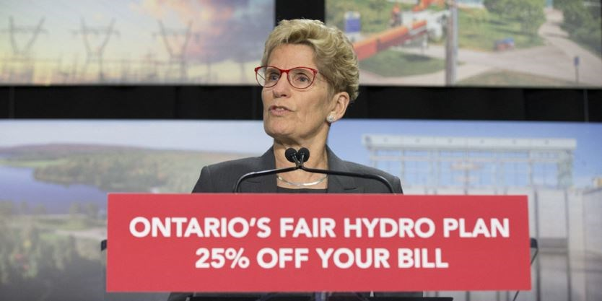
Background
Wynne government focus: Climate Change
Public Focus (provincial): Hydro rates

Slide 3
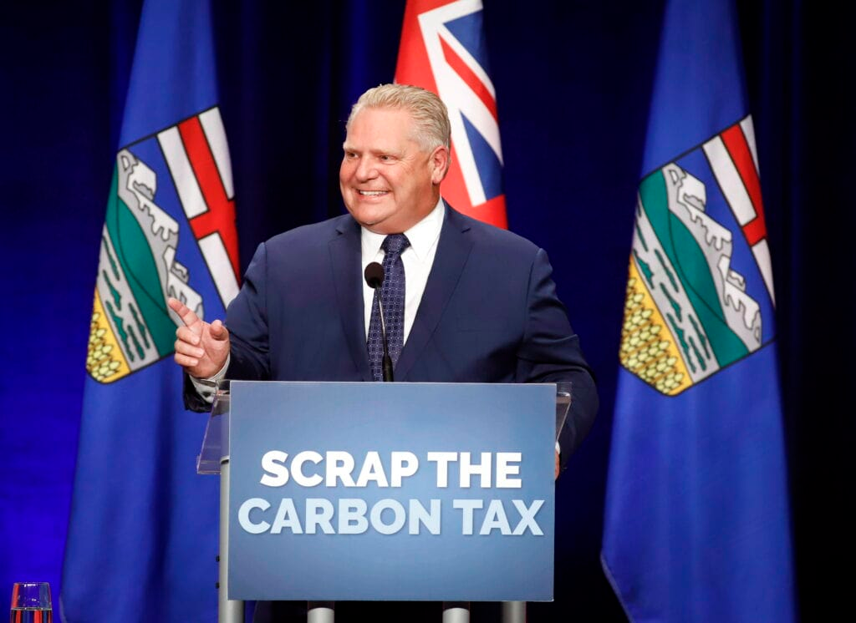
The environment and the Ford governance model
Reactive
Friends with benefits
Creeping (populist) authoritarianism
Spend and not tax conservatives
‘Get it done’

Slide 4
Public Salience of Issue: High | Policy outputs High policy activity. Exploration of environment-economy relationship. Disruption of traditionally dominant policy relationships. Examples Peterson (accord period) Rae (Part I) | Policy outputs Bipolar -- high-profile environmental initiatives matched with major countervailing moves in conventional directions. Policy driven by political management as opposed to reflection on conventional economic model. Examples Peterson (majority) McGuinty (Ist mandate) | Policy outputs Reactive. High profile but one-off initiatives. Maintenance of core policy path. Examples Harris post-Walkerton Eves | Policy Outputs Reactive. High profile but symbolic one-off initiatives. Responsiveness to some industry pressures for transitions. Maintenance of core policy path. Examples None to date. Likely similar to neo-Liberal responses
Public Salience of Issue: Low | Policy outputs Follow-through on existing initiatives. Few new initiatives. Examples Rae (Part II) Wynne – Climate Change | Policy outputs Incremental responses to crises (physical or political). Mitigation of impacts of conventional economic development models. Examples The “dynasty” Davis (1975-84) McGuinty (2nd /3rd mandate) Wynne (except climate change) | Policy outputs Retrenchment. Environment unimportant. Reinforcement of traditionally dominant policy relationships. Examples Miller Harris ‘Common Sense Revolution’ period (1995-2000) | Policy outputs Extreme Retrenchment. Environment unimportant. Near total reliance on established economic interests for policy input. Examples Ford (1st mandate)
Discursive orientation | Activist/progressive | Managerial/facilitative | Neo-liberal | Market/Authoritarian Populist

Slide 5
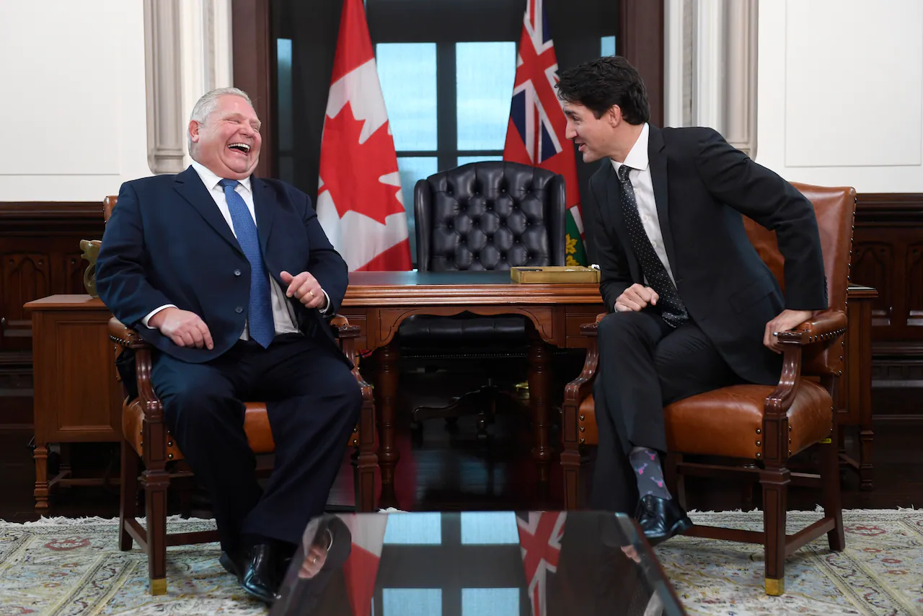
Paths forward?
Biophysical realities (Fires, floods, heat emergencies, extreme weather, cyanobacteria blooms)
Federal role
Net -zero electricity
OBPS
Economic necessity
Steel
EVs and batteries

