Slide 1
Using a TIMES approach to assess low-carbon transport and climate change mitigation policy scenarios
Olivier Bahn olivier.bahn@gerad.ca
Kathleen Vaillancourt kathleen@esmia.ca
November 2019

Slide 2
Simplified classification of E3 models

Slide 3
Simplified classification of E3 models
Top-down
Hybrid
Bottom-up
Less energy details
Full economy
Macro economic
More energy details
Partial economy
Techno-economic
Typically used for:
Macroeconomic impacts (jobs, GDP, etc.) of energy and climate policies
Typically used for:
Evolution of energy systems, emerging technologies, GHG mitigation costs

Slide 4
Simplified classification of E3 models
Top-down
Hybrid
Bottom-up
Less energy details
Full economy
Macro economic
More energy details
Partial economy
Techno-economic
Examples:
General equilibrium models
Econometric models
Examples:
Optimisation models
Simulation models

Slide 5
Simplified classification of E3 models
Simulation
Optimisation
Exploratory models to assess the impacts of changes on energy systems
Previsions
Business-as-usual scenarios
Most likely outcomes
Models that focus on specific criteria (e.g. costs) to assess changes in energy systems
Projections
Energy transition scenarios
Ideal outcomes

Slide 6
The TIMES model generator

Slide 7
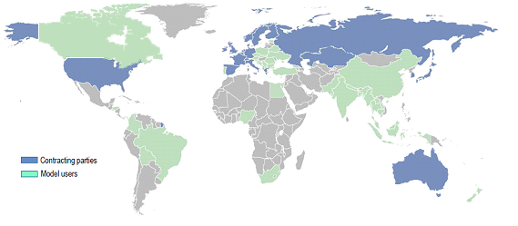
ETSAP – International Energy Agency
Developed within the Energy Technology Systems Analysis Programme (ETSAP) of the International Energy Agency (IEA) since 1978
With the purpose of coming up with a common (optimisation) platform for countries to examine the evolution of their energy systems in response to technology developments and policy priorities
Since then, concerns over economic sustainability, climate change, energy security, and social safety call for an energy revolution with increasing urgency and a joint international effort is even more necessary than forty years ago
Long and rich history of methodological developments and applications to support decision making in nearly 70 countries
Canadian researchers at GERAD are among the prime developers

Slide 8
Reference Energy System (RES)
TIMES is based upon the concept of the Reference Energy System (RES)—or energy network—that represent all possible flows of energy within the integrated energy sector

Slide 9
TIMES Characteristics
TIMES combines advanced versions of MARKAL models
Integrated energy systems: capture the whole energy system (multi-fuel, multi-sector, multi-region)
Demand driven: Useful demands correspond to energy services demands may be elastic to their own prices
Dynamic model: over 30 to 50 years to capture long term structural changes (or even 100 years for climate policies)
Simulates market competitions (of energy carriers and technologies) through an optimisation (LP)
Computes a partial equilibrium
→ minimize the total discounted cost (or equivalently, maximise the net social surplus)

Slide 10
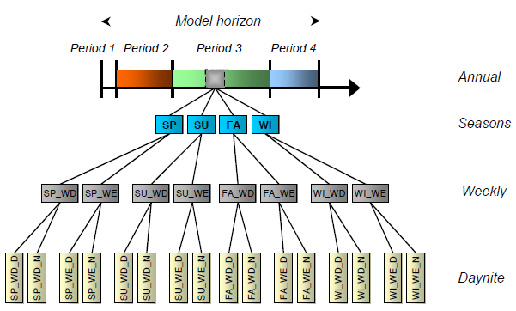
Space and time dimensions
Space
Uni- or multiregional models
Geographical scales:
Global
Continental
Multinational
National
Regional (Provinces, States, etc.)
Cities
Time
Base year
Annual time periods
Milestone years (results)
Annual data (flexibility)
Time slices (seasons and intraday periods)

Slide 11
In summary ….
Techno-economic database
Technical
Inputs and outputs
Availability factors
Efficiencies
Lifetime
Installed capacity
Emission coefficients
Economic
Investment costs
Fix operation costs
Variable operation costs
Hurdle rates
Market shares
Policies
GHG caps
Taxes, subsidies
Sectors’ measures
TIMES
Economic – Energy Inputs
Energy service demands
Demand price-elasticities
Price of imported/exported commodities
Reserve supply curves
Discount rate
Equilibrium
Technology investments and annual activities
Emission trajectories
Adjusted demands for energy services
Marginal prices of energy forms
Imports/exports of energy and emission permits
Total discounted system cost

Slide 12
The NATEM model North American TIMES Energy Model

Slide 13
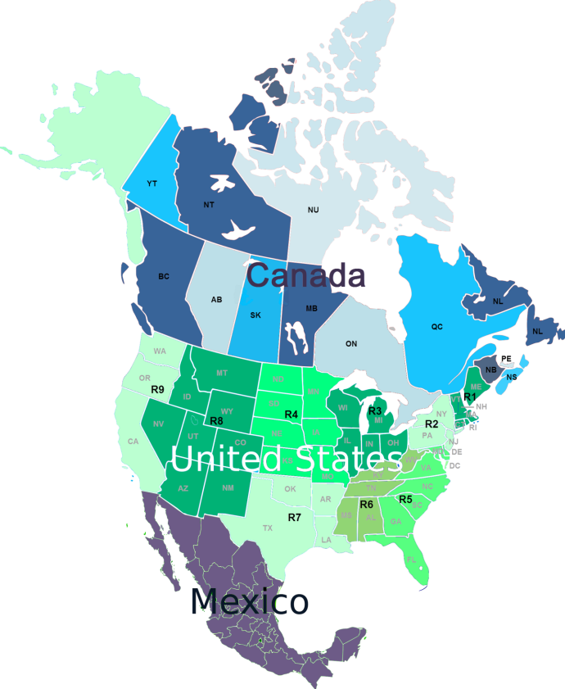
NATEM
TIMES optimization model
Demand driven – energy services
Price-elasticities of demands
Dynamic model over 40 years
Simulates market competitions
Computes a partial equilibrium
→ minimise the total cost discounted at 3-4%
→ compute the marginal reduction cost
Canada – 13 regions
Horizon 2011-2050
9 periods, 16 time slices for electricity

Slide 14
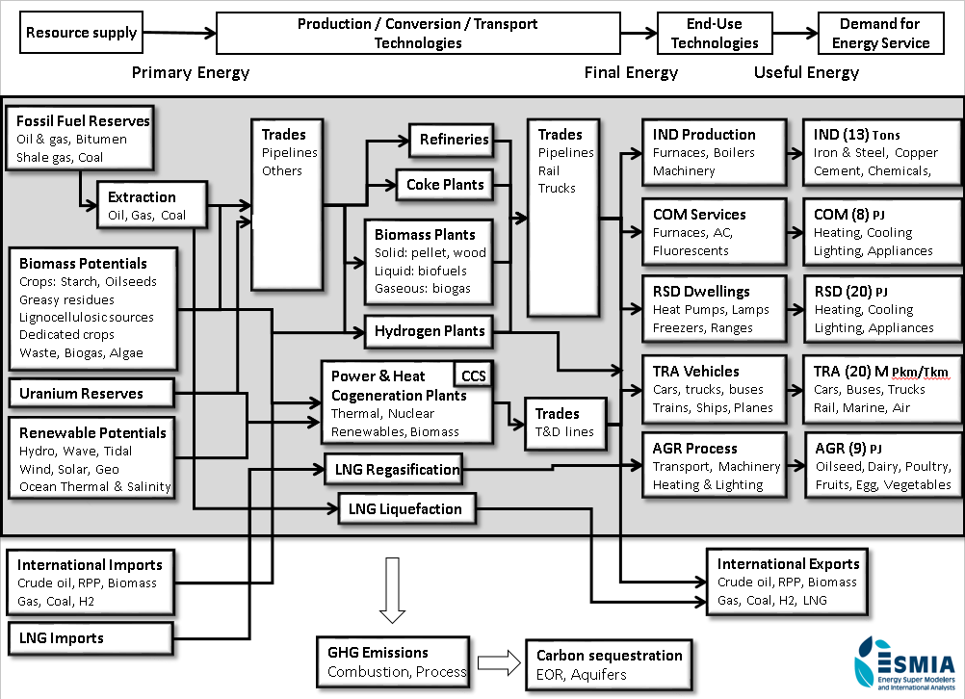

Slide 15
Fuels
Vehicle Type
(ex. small cars)
Vehicle category
Passenger
transportation
Hydrogen
Electricity
Cellulosic E
Gasoline
Small cars, short distance
Methanol
Pkm
Butanol
Biodiesel
Jet fuel
Fuel oil
Propane
FT diesel
Ethanol
Biojet
LNG
CNG
Diesel
ICE, Standard, GSL
Small cars, long distance
Pkm
ICE, Standard, DST
Pkm
Large cars
ICE, Improved, GSL
Light trucks
Pkm
ICE, Improved, DST
Urban buses
Pkm
ICE, Hybrid, GSL
Intercity buses
Pkm
ICE, Hybrid, DST
School buses
Pkm
Flex fuel
Motos
Pkm
Off road
Pkm
Natural gas
Trains
Pkm
Propane
Airplanes
Pkm
PHEV20 Lithium-ion
Vehicle category
Freight
transportation
PHEV50 Lithium-ion
Light trucks
Tkm
BEV150 Lithium-ion
Medium trucks
Tkm
BEV300 Lithium-ion
Heavy trucks
Tkm
Trains
Tkm
Charging station, Residential
Airplanes
Tkm
Charging station, Public
Ships
Tkm

Slide 16
Scenario analysis approach

Slide 17
http://iet.polymtl.ca/tefp

Slide 19
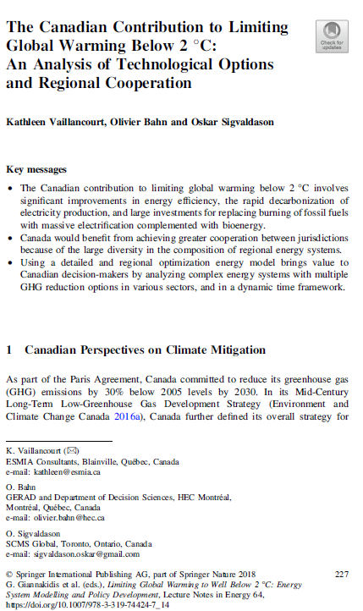
https://www.springer.com/gp/book/9783319744230

Slide 20
The only Outlook including deep decarbonisation scenarios in Canada.
Results at the provincial level.
Reduction scenarios up to -80% by 2050 from 1990 levels.
This goal, like the intermediate GHG targets, will be missed by a lot unless there is a significant turnaround.
iet.polymtl.ca/energy-outlook

Slide 21
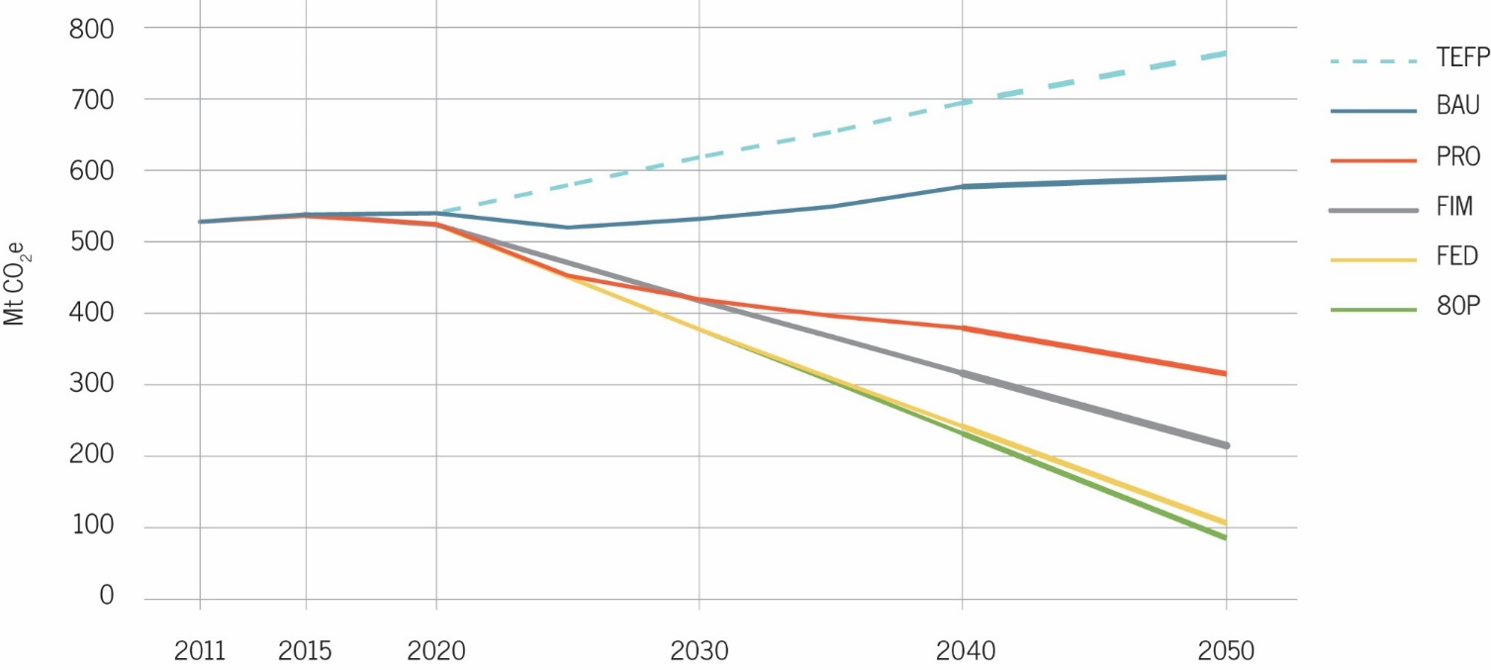
Scenarios for GHG mitigation
BAU : Existing policies
PRO : Individual provincial targets
FED : Federal targets (30% by 2030 and 80% by 2050, from 2005 levels)
All reductions must be achieved domestically.
FIM : Federal targets with 25% international carbon market purchases
80P : Deeper target (80% by 2050, from 1990 levels)

Slide 22
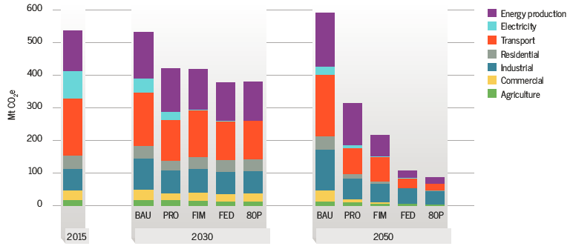
GHG emissions by sector

Slide 23
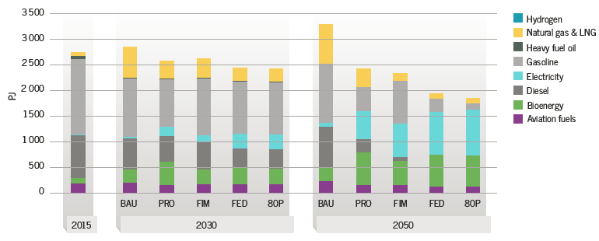
Final energy consumption - transportation

Slide 24
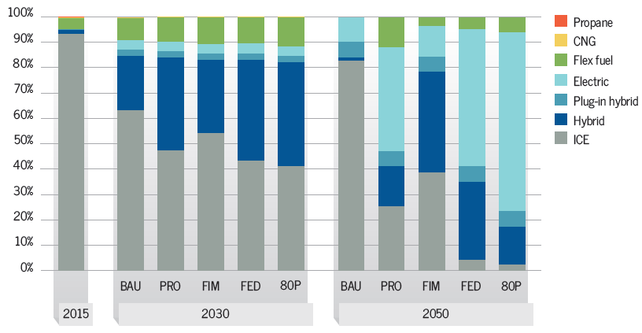
Market shares of light-duty vehicles

Slide 25
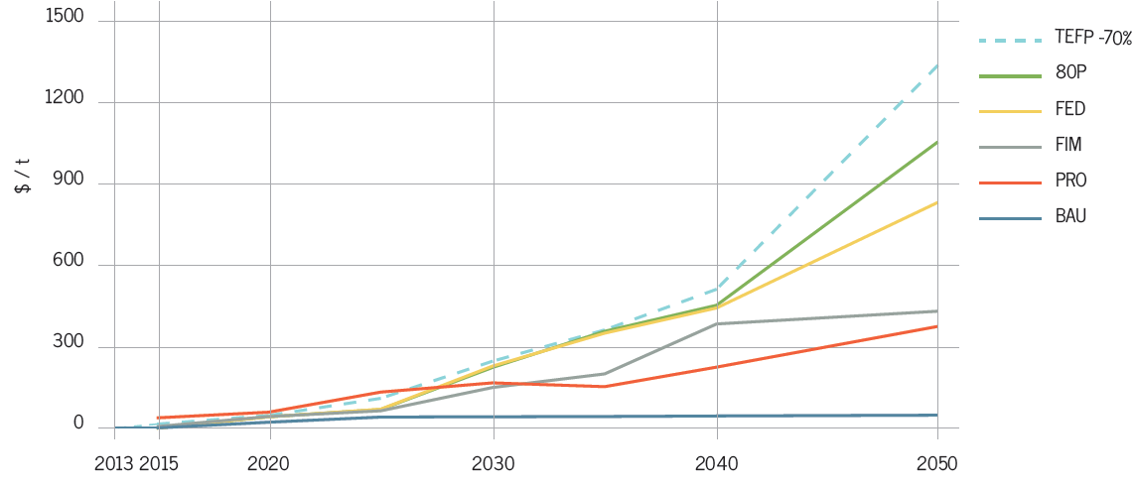
Marginal reduction cost

Slide 26
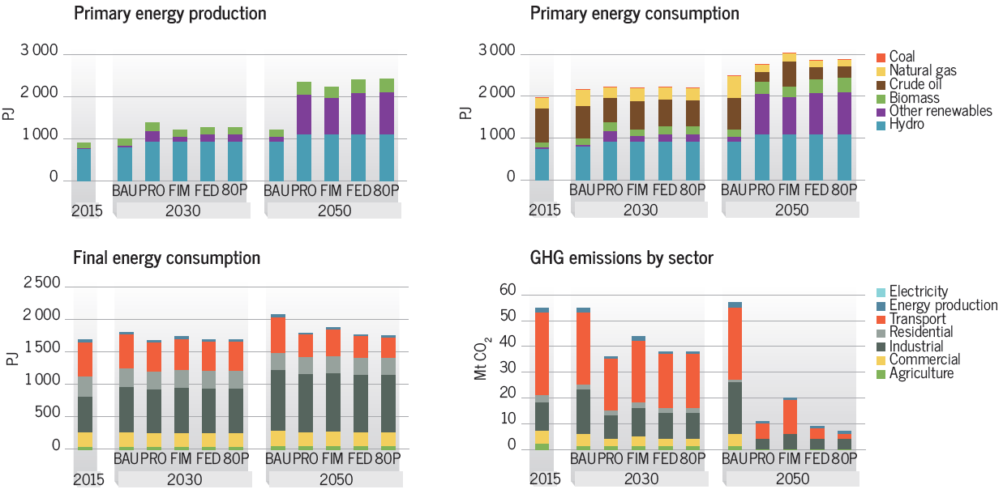
All results available by province - Quebec

Slide 27
Thank you for your attention!
July 2019
November 2019

Slide 28
EXTRA SLIDES

Slide 29
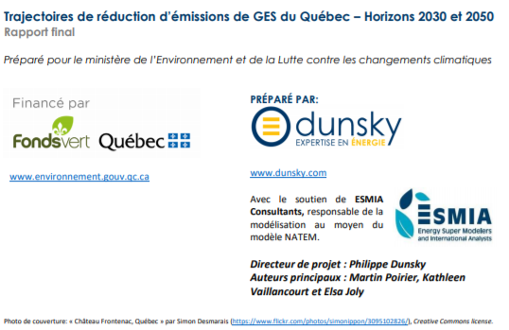
For the Ministry of Environment of Quebec (MELCC)
http://www.environnement.gouv.qc.ca/changementsclimatiques/trajectoires-emissions-ges.pdf

Slide 30
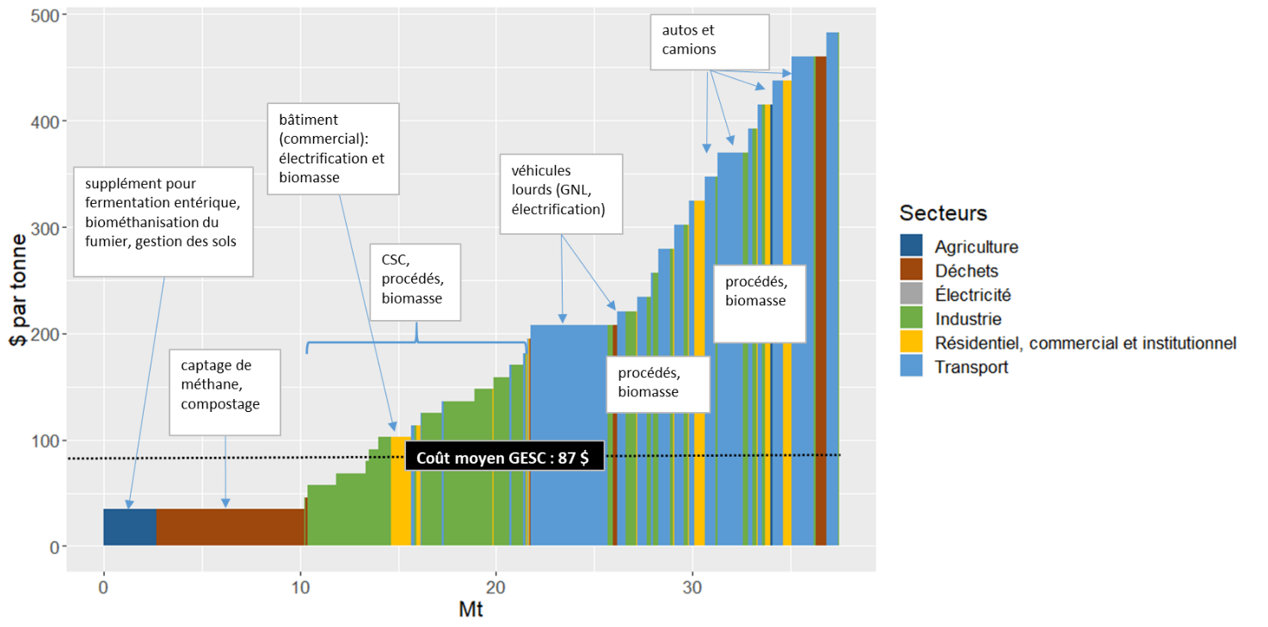
Marginal abatement cost curves for 2030

Slide 31
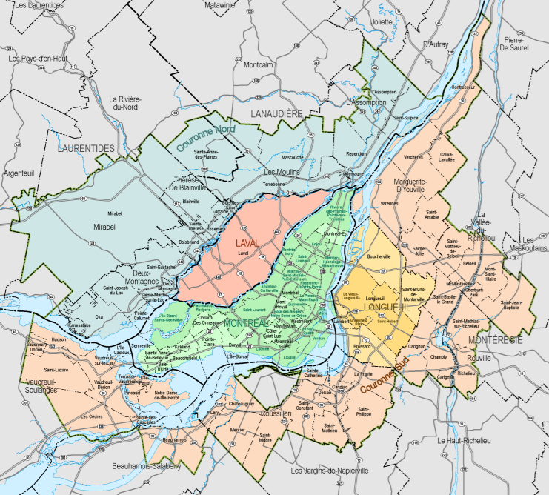
For the Metropolitan Montreal Community
Montreal wants to be a leader in climate action, by achieving carbon neutrality in 2050.
Collaboration to develop a GHG reduction plan, an adaptation / resiliency plan and define new GHG reduction measures in consultation with key stakeholders.
Modeling is necessary to establish GHG reduction trajectories that allow to achieve the objectives of five metropolitan zones in 2030 and 2050.
Development of a multiregional urban TIMES model for the five zones of the Metropolitan Montreal Community (MMC).

Slide 32
Technology mixes at a finer special resolution

