Slide 1
Electric Vehicle Energy Demand and Regional Electricity Generation
Modeling Overview
JCCTRP Toronto Workshop
Jonathan Dowds
November 11th, 2019

Slide 2
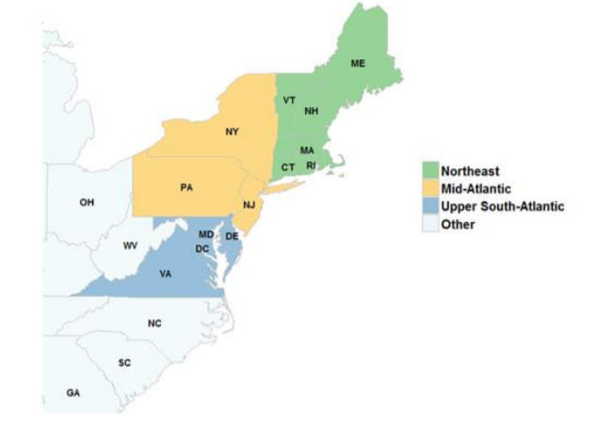
Policy Environment in the Northeast united states
Regional Greenhouse Gas Initiative
Electric power sector specific cap-and-trade program launched in 2009
Transportation and Climate Initiative
Transportation sector specific cap-and-trade program in development
December 2019: Draft MOU & Modeling Results
Spring 2020: Final MOU
2021 Rulemaking
2022 Possible implementation
Notes:
RQs

Slide 3
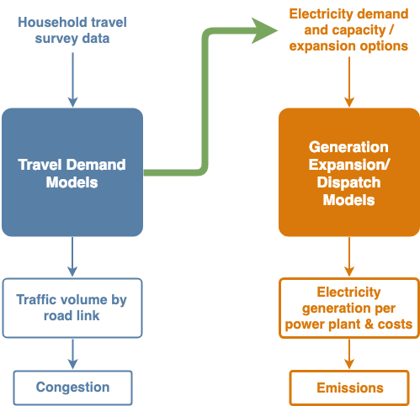
Research Overview
What is the cost of the deep decarbonization of the transportation sector via vehicle electrification?
PEV Charging Demand Model: How do you get from travel behavior data to realistic hourly electricity demand?
Regional Electricity Generation & Dispatch Model: What power plant should be utilized when to serve the demand for electricity?
Combined: How will vehicle electrification impact the power generation in terms of costs, emissions, renewable utilization, etc.?
Notes:
RQs

Slide 4
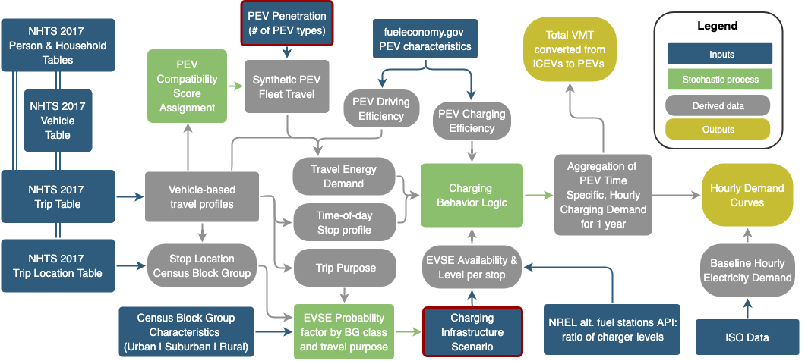
PEV Charging Demand Model OVERVIEW

Slide 5
Daily Vehicle travel to weekly vehicle charging
Construct a full week by sampling 5 weekday and 2 weekend vehicle profiles from the NHTS
Run charging behavior algorithm on travel profiles to get full week of hourly charging demand

Slide 6
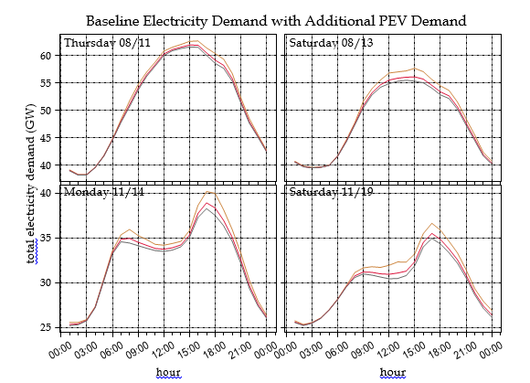
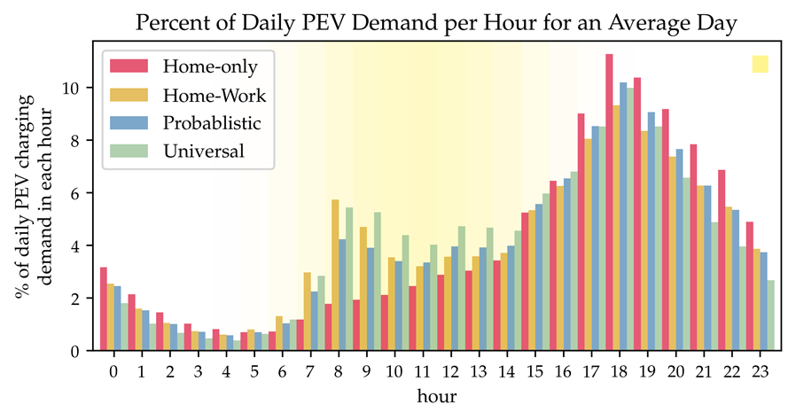
PEV Demand in context

Slide 7
Regional economic dispatch model
Model Formulation:
Objective function: minimize cost of generation based on marginal costs c_{g}
Power balance constraint: supply == demand at every hour
Capacity constraint: based on maximum capacity and capacity factors for each generation source
Greenhouse gas emissions constraint: annual generation times the emissions rate, r_{GHG} must be below the cap, GHG_{max}
Nitrogen Oxide (NO_{x}) emissions constraint: annual generation times the emissions rate, r_{NOx} must be below the cap, NOx_{max} (only applies to NY plants & for ozone season only)

Slide 8
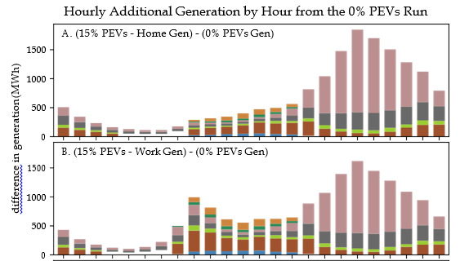
Regional economic dispatch model results
PEV penetration | EVSE scenario | GHG from Electricity Generation | GHG from Annual ICEV VMT | Total GHG Emissions | Emissions Reduction | Percent
0% |  | 25,798,713 | 85,191,910 | 110,990,623 | 0 | 0.00%
15% | Home | 28,255,397 | 77,743,286 | 105,998,683 | 4,991,940 | 4.50%
 | Work | 28,223,080 | 77,350,988 | 105,574,068 | 5,416,555 | 4.88%
 | Probabilistic | 28,238,224 | 77,346,823 | 105,585,047 | 5,405,575 | 4.87%
 | Universal | 28,273,946 | 76,871,248 | 105,145,194 | 5,845,429 | 5.27%

Slide 9
On-Going & Future Research Topics
What are the impacts of considering a lager, transnational region (Quebec/Ontario)?
What level of transmission interconnection is required?
How does PEV charging demand align with: baseline demand, peak load, renewable energy availability?
How does this vary with charging infrastructure availability/assumption about charging preferences?
How does this additional demand impact generating costs and emissions?
What are the impacts of emissions caps/emissions trading?
Does PEV demand shift the most cost-effective mix of wind and solar installation?
What are the systemic benefits that could be achieved through optimized charging?
Are these benefits large enough to incentivize drivers to participate in smart-charging programs?
Notes:
All renewable energy is used to meet baseline 2030 demand in the high renewable case so PEV charging results more dispatch of fossil fuel plants therefore increases emissions and generating costs

