Slide 1
California update: Getting to zero emission heavy duty trucks
Genevieve Giuliano
University of Southern California
JCCTRP Workshop
York University
November 6, 2019

Slide 2
Research team
Genevieve Giuliano (USC) Maged Dessouky (USC) Marshall Miller (UCD) Thomas O’Brien (CSULB) Seiji Steimetz (CSULB) | Sue Dexter (USC) Jiawen Fang (USC) Shichun Hu (USC) Ben Olson (CSULB)

Slide 3
The problem
Transport sector GHG emissions by source
Source: US Environmental Protection Agency, 2018

Slide 4
The challenge
California has nearly 40 million people
  All of them consume goods
  More of them are shopping online
  Some of them love instant deliveries
California is the world’s 5th largest economy
California has the US’ largest share of international trade
Freight shipments are increasing, heavy duty truck traffic is increasing

Slide 5
A comprehensive program to reduce freight sector GHGs
California Sustainable Freight Action Plan (2016)
  Freight efficiency target
  100,000 ZE heavy duty vehicles by 2030
  Economic competitiveness target
Graduated requirements for lower emission diesel trucks
  By 2023 all trucks 2010 model year or newer
Efforts to promote heavy duty ZEVs
  Demonstration program
  Purchase incentives
  In progress: ZE mandate = BE mandate

Slide 6
Even more action in Southern California
South Coast Air Quality Management District
  Indirect source requirement
  ZE demos
Ports of Los Angeles and Long Beach
  Clean Air Action Plan 3.0
  ZE ports by 2035
  New trucks 2014 model year or newer
  Two tier entrance fee, lower rates for ZE or near NZE (proposed)

Slide 7
Results: Transport sector GHG inventory, CA
Year | 2000 | 2002 | 2004 | 2006 | 2008 | 2010 | 2012 | 2014 | 2016
Total GHG Emission | 183.86 | 191.59 | 191.21 | 193.31 | 182.64 | 170.16 | 166.16 | 167.14 | 174.01
CO₂ | 173.39 | 181.08 | 180.65 | 182.87 | 172.74 | 160.75 | 157.33 | 158.64 | 165.87
N₂O | 6.91 | 6.54 | 5.97 | 5.24 | 4.43 | 3.95 | 3.58 | 3.37 | 3.27
Methane | 0.68 | 0.62 | 0.56 | 0.49 | 0.41 | 0.36 | 0.31 | 0.27 | 0.24
Units = million ton CO2 equivalents
Source: CARB, 2018

Slide 8
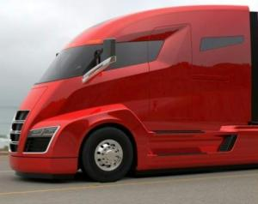
Our research: ZEVs in drayage
Goals
  Feasibility of BE technology in drayage
  Target fleets/markets for BE technology
Question
  Given current experience (2019) and expected performance (2030), what share of market can be served without changing current operational patterns?
Tesla Semi

Slide 9
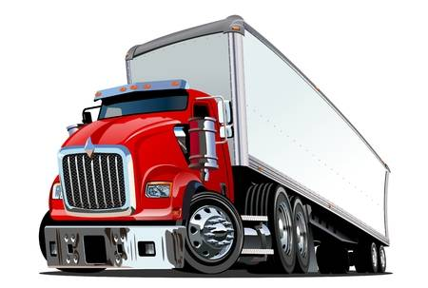
ZEV challenges
Performance
  Range: 400+ miles for diesel, ~100 for BE
  Refueling: 15 min for diesel, up to 6 hours for BE
  Price: $150K for diesel, $300K for BE
  Capacity: ~ 45K lbs for diesel, 35-40K for BE
Performance differences affect operations
  The greater share of BE, the more total vehicles and vehicle miles required
  NOT a one to one substitution

Slide 10

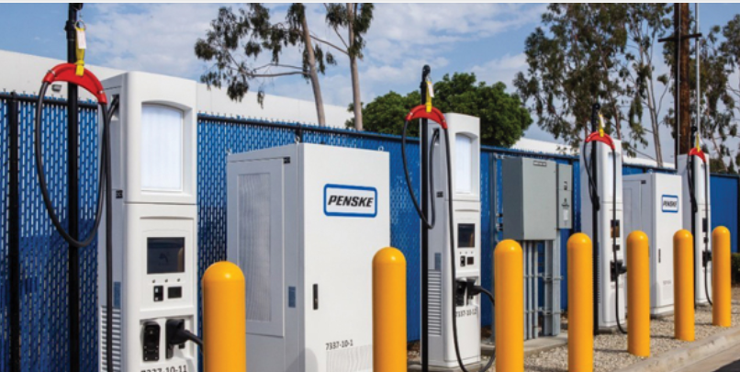
Research methods
Simulation/optimization
  One and two link tours based on port survey data
Case studies of two firms (so far)
Interviews and surveys of fleet owners
Stated preference surveys of fleet owners

Slide 11
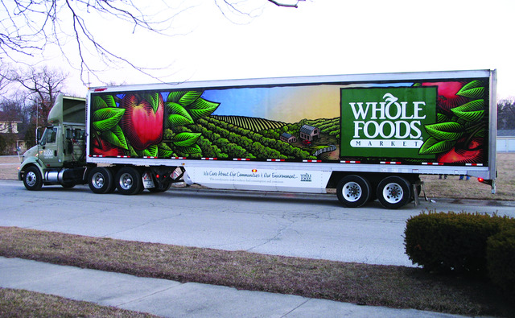
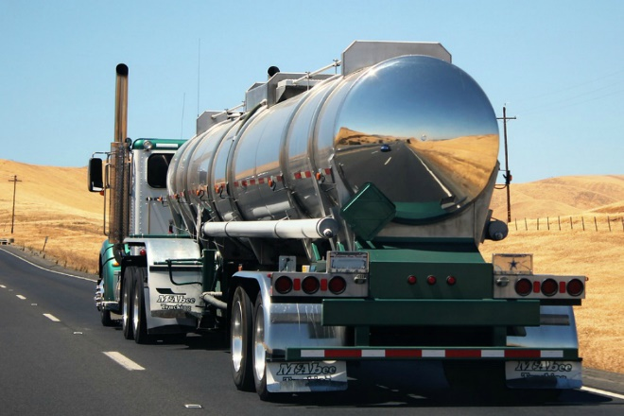
Case study participants
Firm 1
  Transloading
  Drayage & direct delivery (chemicals, liquids, dry bulk)
  Own all trucks
  Work 1 shift
  Fleet drivers + owner operators
Firm 2
  Warehousing
  Drayage & direct store delivery (natural foods)
  Lease 23 trucks
  Multiple shifts, almost 24/7
  Fleet drivers

Slide 12
Results: share of operations served
Firm 1
 | Battery cap | Share
2019 | 240 kwh | 8%
2030 | 650 kwh | 64%
Firm 2
 | Battery cap | Month 1 | Month 2
2019 | 240 kwh | 21% | 32%
2030 | 650 kwh | 76% | 88%

Slide 13
Conclusions
Market for ZE heavily influenced by range and weight
  Tesla promise would be break through
More ZE trucks required to serve same market
Concerns
EV manufacturer range is overstated
Range will improve, but how fast?
Demonstrations limited
EVs may require restructuring of fleet composition and use
Charging
  Infrastructure, charge locations, time, cost
Cost
  BE 2-4x more $$ than diesel
  Incentives not typically structured for shorter trips

Slide 14
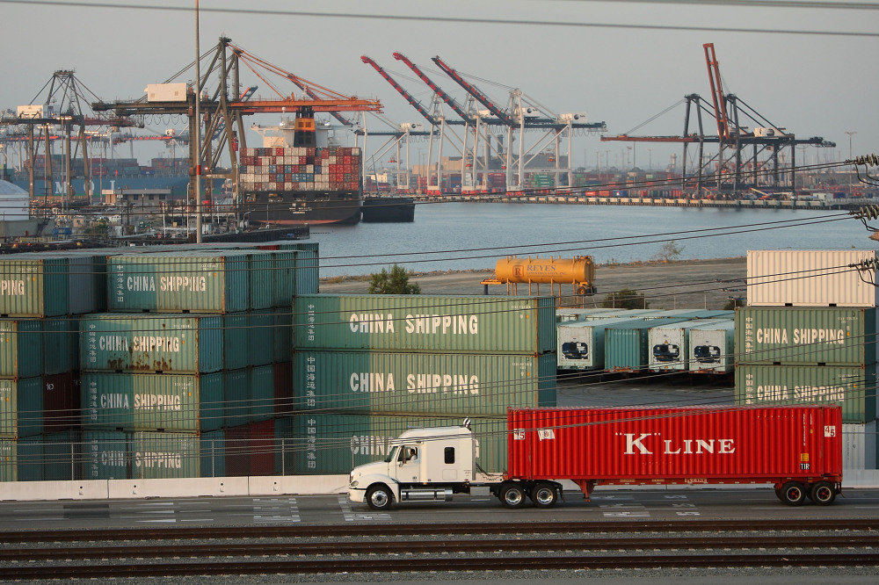
Thank you
giuliano@usc.edu

