Slide 1
Teaching Energy Efficiency in post secondary settings: experiences from our Master’s program in Sustainable Energy Policy and Engineering
Alex Mallett
Assistant Professor
Teaching Energy Efficiency Workshop – York University
July 17, 2014

Slide 2
Overview
Carleton’s master’s program in Sustainable Energy Engineering and Policy
Teaching EE (non technical dimensions) to engineers
Engineering and Policy student research projects
Areas of research / expertise on energy efficiency

Slide 3
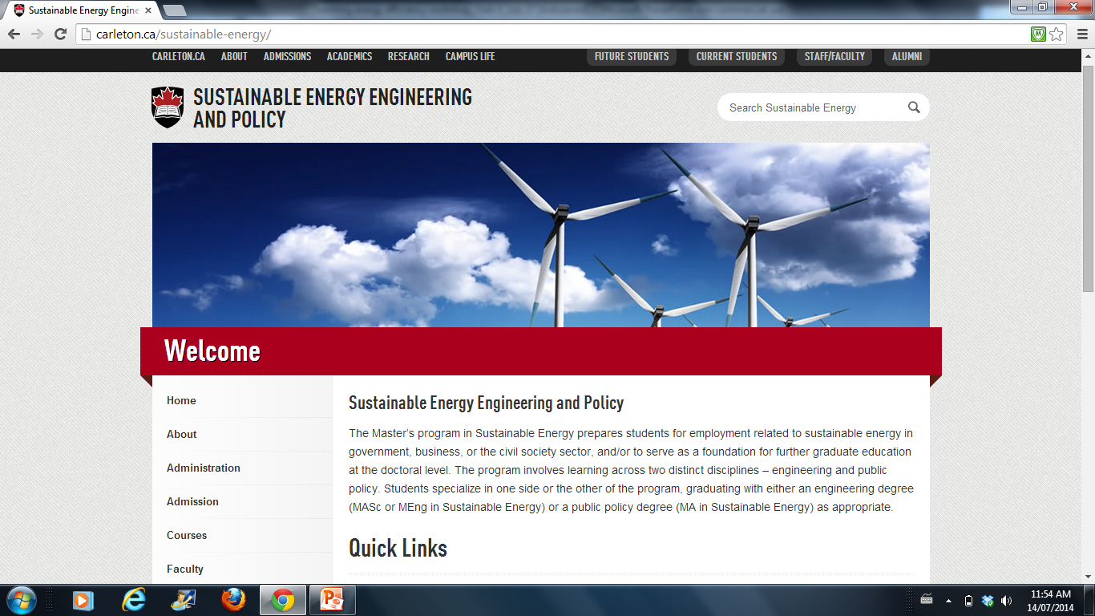
Notes:
Started in 2010

Slide 4
SERG 5000 - Sustainable Energy Policy for Engineers
Graduate level seminar
Non-technical dimensions of understanding actions (or inactions) around technologies / behaviours
i) Energy, public policy and government context
ii) economic, social and political dimensions of sustainable energy
iii) energy policy in Canada and
iv) case studies

Slide 5
Sustainable Energy Policy for Engineers
Objectives
Foster skills in critical thinking / questioning assumptions
Understand technologies within larger contexts – economic, social and political dimensions (moving beyond the ‘university lab to market’ model; historical legacies)
Barriers / resistance to technology adoption
Content – energy and policy
Approach
Literature-based seminar, debates, simulations, independent research, applying theories / concepts to ‘real world’

Slide 6
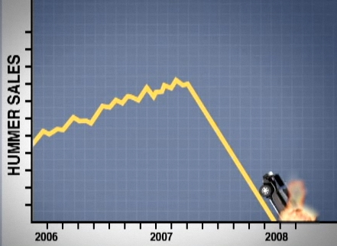
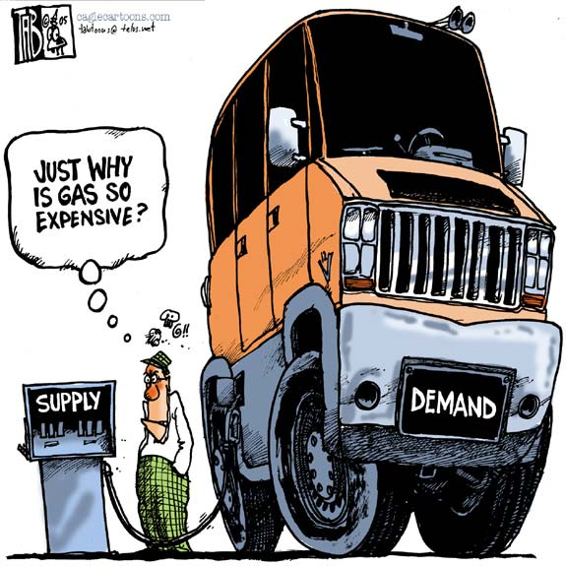
General Concepts – supply and demand

Slide 7
Public Policy
WHAT
Problem, Goals, Instruments
WHY
Conventional economic theory won’t work
Urgency
Public good
Externalities
HOW
Governance in Canada

Slide 8
Types of reasoning (Policy Drivers)
Role of ideas / values / normative
Legal
Logical
Empirical
Time frame (crises vs. ‘regular’ circumstances) – energy scares (Langlois-Bertrand)
“Decision-based Evidence Making”

Slide 9
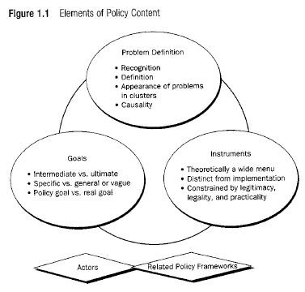

Slide 10
Policy instruments (Pal 2013)
Do nothing
  Problem-related, resource-related, precedent-related, self-corrective system rationales
Act indirectly
  Information, expenditures, regulation
Act directly
  State agency, state corporation, third party partnership

Slide 11
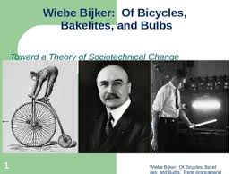
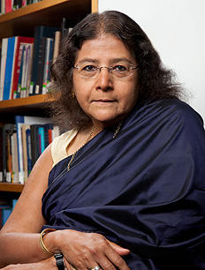
Social Construction of Technology and Policies
Notes:
Bijker, Jasanoff, Koomey – Sorry wrong number

Slide 12
Koomey – Sorry, Wrong number
Notes:
Mutant statistics – aggregation, estimates, recognizing - critiquing, questioning assumptions behind their simulations

Slide 13
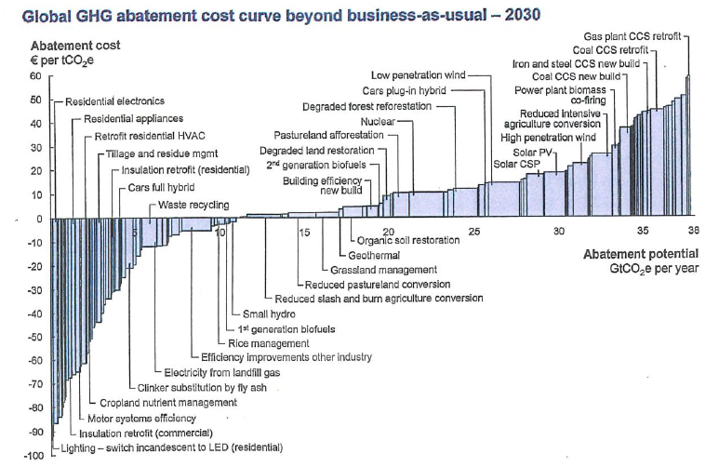
McKinsey (Meier) carbon abatement cost curve

Slide 14
Energy Efficiency
Sorrell et al 2004 – market / technical barriers to socio-technical system e.g. hidden costs, information asymmetry, bounded rationality, split incentives, inertia, culture
the Energy Efficiency Gap (Brown)
Jevons’ Paradox, Rebound effect
Social acceptance, consumer behaviour

Slide 15

Notes:
Nudge

Slide 16

Thaler and Sunstein - Nudge

Slide 17


Slide 18
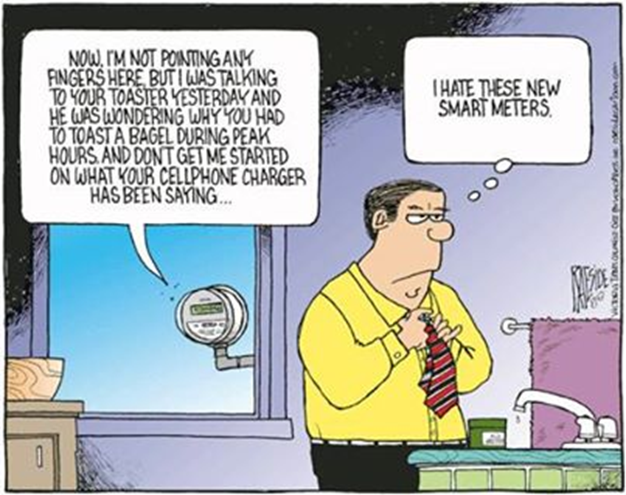
Notes:
Talk about Niraj’s point – choice – people willing to cede info to facebook, etc – their choice

Slide 19
SERG 5000 – Engineering and Policy student research projects
Interdisciplinary teams (~ 4 students)
New – something that has never been done
Student-driven projects
Guided by faculty members
Present to key players in sector (within and outside of university) end of semester

Slide 20
Key EE (or EE + generation) projects (2010-2014):
  Retrofitting of Parliament buildings
  EE opportunities for Hall Beach, Nunavut
  Heat recovery in buildings in Ottawa
  Community integrated solar passive design (Ottawa)
  Summer peak shift in City of Windsor
  Greening of data centres
  Green Building Design for Low-income Families (Toronto)
  BUT also draw from EE experiences e.g. adaptation of HELP program in Toronto (for solar pool pumps in Toronto)

Slide 21
EE Research
Mallett
MN Department of Commerce (University of Minnesota) – barriers and policy options for EE in higher education
UK-India Phase II research (University of Sussex with TERI) – case study on EE technologies for SMEs
UNIDO studies on barriers and policy options for industrial EE

Slide 23
EE Research
Policy
Unlocking the potential of smart grids (with Meadowcroft, Toner, and others)
Examining policy effectiveness (NBS) and governance of natural resources (with Auld, Mills, Slater and others)
Stoney and Hilton – municipal infrastructure
See carleton.ca/cserc

Slide 24
EE Research
Engineering
Energy Efficient and Net-Zero Energy Buildings (Ian Beausoleil-Morrison and Cynthia Cruickshank)
Solar control and daylighting, Green roofs and occupant behaviour in buildings (Liam O’Brien)
Building Performance Simulation – (Ian Beausoleil-Morrison)
Power grid optimization (Craig Merrett)
microgrids (Xiaoya (Kevin) Wang)

