Slide 1
Conservation First
Policy Context for Energy Efficiency in Ontario
York University

Slide 2
Where We’ve Been and Where We’re Going

Slide 3
Conservation in Ontario – Past, Present and Future
The new framework is based on key learnings from the 2011-2015 CDM framework and reflects feedback received from LDCs and other stakeholders
Conservation First
CDM Framework
2015-2020
Target of 7TWh by the end of 2020 established
LDCs to deliver conservation programs to each customer segment
LDCs provided with long term stable funding, more accountability for program development
Customers will be given more CDM program choice along with streamlined oversight and administration
Agency Coordination
2011-2014
Third Tranche
2008-2010
2005-2007

Slide 4
What We’ve Achieved

Slide 6
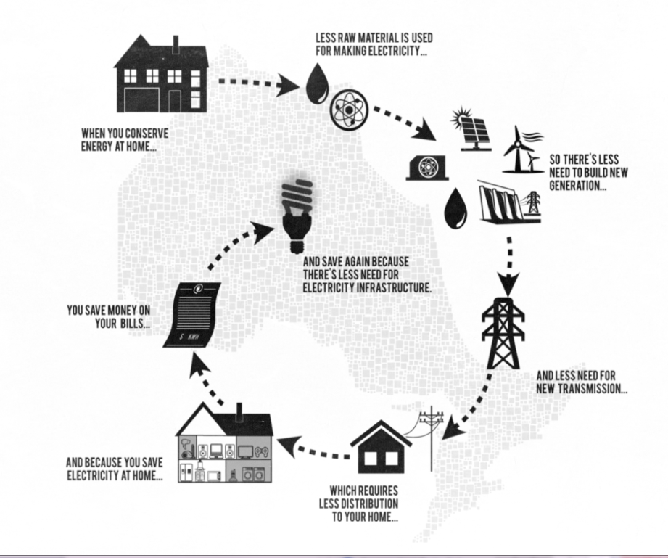
Conservation in Ontario – Where are We Today
Ontario has already made great strides is building a culture of conservation and is one of the reasons Ontario is in a strong supply situation today.
From 2006 to 2012, electricity conservation efforts resulted in
  7.6 terawatt (TWh) of savings in 2012 (projected savings of 8.6 TWh in 2013)- enough to power a city about the size of Mississauga
  2,445 MW of peak demand – equivalent to twice the average demand of Hamilton and Kitchener combined.
From 2000 to 2012, natural gas conservation programs contributed to a total of 1,985 million cubic metres of natural gas savings in 2012- equivalent to the amount of natural gas used by 90,000 Ontario homes.
Role of Conservation

Slide 7
Policy and Planning Context for Conservation in Ontario

Slide 8

Conservation First White Paper
Purpose
On July 16, 2013, Conservation First put forward a consultation document with a renewed vision for conservation in Ontario and committed to expanding and enhancing its conservation efforts.
Vision
Putting Conservation First before building new generation and transmission facilities, where cost effective.
Inspiring Action by better aligning consumer awareness of the benefits of conservation with tools.
Providing Different Tools for Different Customers, tailoring tools to the needs of different customers.
Encouraging Innovation to better support local needs.
Leading by Example with the Ontario government as well as the broader public sector continuing to play a leadership role in conservation efforts.

Slide 9

Context for Action: Ontario’s Long-Term Energy Plan
On December 2, 2013, Ontario released its updated Long-Term Energy Plan, Achieving Balance.
Ontario’s updated Long-Term Energy Plan is a balanced approach to meeting energy needs today and for generations to come.
The plan was developed following extensive consultation with First Nation and Métis communities, stakeholders, municipalities and consumers from across Ontario.
The 2013 plan is built around five key principles:
  Cost-effectiveness
  Reliability
  Clean energy
  Community engagement and
  Putting conservation first

Slide 10
Conservation In Ontario's Long Term Energy Plan
Putting conservation first means that as we plan for our electricity needs, conservation will be the first resource considered before building expensive new generation and transmission facilities, wherever cost-effective.
Ontario has established a conservation target of 30 terawatt hours (TWh) by 2032
    Equivalent to more than all the power used by the City of Toronto in 2012.
Ontario will aim to meet 10% of it peak demand through demand response initiatives by 2025.
Conservation and demand management provides multiple benefits to Ontarians, including:
  Helping Ontario families and businesses save money on their energy bills
  Reducing the need to build expensive generation and transmission, mitigating upward pressure on electricity prices
  Growing the economy and creating jobs
  Reducing greenhouse gas emissions and air pollution

Slide 11
Conservation in LTEP
Forecasted conservation through programs and improved standards is expected to offset almost all of the growth in electricity demand and a substantial portion of peak demand to 2032.
Demonstrates additional resources required to meet demand. Options to meet this need include additional conservation and demand response and clean imports.
Conservation

Slide 12
Policy Foundation for Conservation in Ontario

Slide 13
Conservation Policy
Ontario’s policy is to consider conservation before new supply where cost effective
The province’s Demand Response goal to reduce 10% of peak summer demand by 2025 (~2,400 MW) will be achieved through Dispatchable loads, Time Of Use and other price response initiatives. Existing DR is also being transitioned from an OPA program approach to a IESO market based approach.
Moving forward, LDCs will be required to deliver conservation to each customer segment as a condition of license
Distributors will be encouraged to work together within 21 regions, aggregating targets and co-operatively developing regional CDM plans
Lost revenues that result from conservation programs will not act as a disincentive to Distributors
The Ontario Energy Board will also take steps to put conservation first in electric and gas distributor infrastructure planning processes at the regional and local levels
The government is also taking steps to encourage natural gas conservation. The Ontario Energy Board will establish a new six-year natural gas DSM Framework, to coordinate and integrate the delivery of natural gas and electricity conservation programs, as will the OPA.
The DSM framework will enable the achievement of all cost-effective DSM and more closely align DSM efforts with CDM efforts

Slide 14
Conservation First Implementation
The new Conservation First Framework was implemented through a Direction to the OPA and a Directive to the OEB
  OEB Directive provides the regulatory context and role of the OEB
    Establishes delivery of conservation programs to each customer segment as a condition of license for LDCs.
    Establishing conditions for a new 6 year DSM framework
  OPA Direction provides the operational context governing the OPA/LDC relationship
    Provides LDCs with long-term stable funding and budgets to deliver CDM programs over six-years to achieve a total of 7 TWh of conservation.
    Facilitates the transition of Demand Response (DR) from an OPA program approach to an IESO market based approach.
To support the implementation of Ontario’s new Framework by begin the process of LDC collaboration the OPA formed the Conservation First Advisory Working Group (CFAWG) after it received the direction.
The objective of CFAWG is to finalize the design of the key components—i.e., targets and budget allocation, performance incentives and remedies, contracts and CDM plans—required to enable program delivery by January 2015.

Slide 15
Other Ministry Conservation Policy Initiatives

Slide 16
Product Efficiency Standards
Energy efficiency regulations are a widely-used tool to set minimum energy performance standards for energy using products to remove the least efficient products from the market.
Ontario has been regulating the energy efficiency of products and appliances since 1988.
The ministry committed to helping consumers choose the most efficient products for their homes and businesses by showing leadership in establishing minimum efficiency requirements for products
The most recent major amendment to Ontario’s energy efficiency regulation, O. Reg. 404/12, which set or enhance the minimum efficiency standards for 25 products (such as water heaters, boilers, household refrigerators, dishwashers, clothes washers and dryers, televisions, fluorescent lamps and small motors) that became effective on January 1, 2014 positioned Ontario as a leader in regulating energy efficiency of products and appliances.
Ontario regulates more products than any other jurisdiction in Canada (including the federal government) and has the most stringent efficiency standards for a number of products, such as residential appliances (refrigerators, clothes washers/dryers, dishwashers, room ACs), lighting products (fluorescent lamps and ballasts, general service lighting) and some of HVAC and water heating products.

Slide 17
Broader Public Sector Reporting And Conservation Plans
A key conservation initiative that will assist Ontario in achieving its conservation goals is the energy reporting and conservation plan regulation (O. Reg. 397/11) developed under the Green Energy Act, 2009.
O. Reg. 397/11 requires broader public sector (BPS) organizations to:
Report by July 1st annually to the Minister on their energy use and greenhouse gas (GHG) emissions beginning on July 1st, 2013
Develop and publish a 5-year conservation and demand management (CDM) plan every 5 years beginning July 1st, 2014
Make their annual reports and conservation and demand management plans publicly available on their websites
Roughly 720 BPS organizations report annual consumption of all fuel types for over 20 operation types which are converted to an energy and GHG intensity figure. Reports are made public by each organization and the Ministry makes all data available on the Ontario One data web site.
Last year compliance rate was 95%

Slide 18
Municipal Energy Plan Program
The Municipal Energy Plan (MEP) program was launched in August 2013 to support municipalities’ efforts to better understand their local energy needs, identify opportunities for energy efficiency and clean energy, and develop plans to meet their goals.
A MEP is a comprehensive plan designed to align energy, the built environment and land use planning to identify community-wide energy efficiency options and support economic development opportunities. MEPs will help municipalities:
  Assess the community’s energy use and greenhouse gas (GHG) emissions
  Identify opportunities to conserve, improve energy efficiency and reduce GHG emissions
  Consider impact of future growth and options for local clean energy generation
  Support local economic development.
The MEP Program provides successful applicants with funding for 50 per cent of eligible costs, up to a maximum of $90,000 to develop a municipal energy plan.
The ministry has completed its first round of MEPs applications with 8 successful applications and just launched a ssecond window for applications.

