Slide 1
Teaching Energy Efficiency Workshop
Paul Parker, University of Waterloo
York University
16-17 July 2014

Slide 2

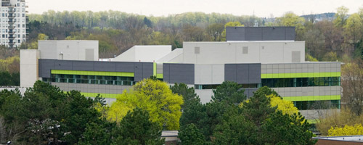
Energy and Sustainability
Geog 459 Paul Parker
Geography and Environmental Management, UW
Text: Everett et al. 2012
Energy Systems and Sustainability
Oxford University Press
Source: http://www.solarpowerathome.com/energy-efficient-home.html

Slide 3
Energy Flow Diagram for Canada (mtoe): 2005
Environment Canada, 2009; IEA, 2009. Note: *includes hydro, solar, geothermal, combustible materials and waste.

Slide 4
Assignments: Develop Problem Solving Skills
1. Global Climate and Energy Systems
2. Cut residential GHG emissions by 50%
3. Create community energy plan with GHG emissions cut of 75%
Real data, no single solution!

Slide 5
A1 Global Climate and Energy Systems
…You have been hired to explain how the models work, to evaluate them, to compare scenarios developed by the SRES, and to offer a new scenario for the future, based on your policy recommendations.
http://jcm.climatemodel.info/

Slide 6
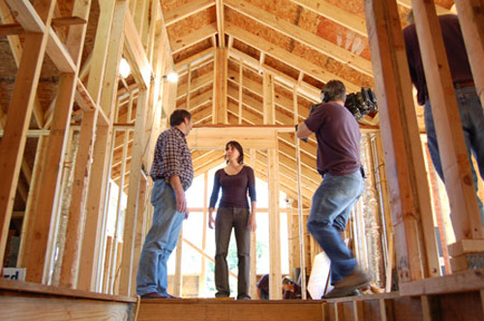
A2: Objectives
Plan to reduce residential emissions by 50%
First identify areas of heat loss
Possible actions:
Insulating building envelop
  Attic
  Walls
  Foundation
Air sealing
Windows and doors
Switch fuels
  to less carbon intensive
Replacing furnace
Replacing water heater
Add Heat recovery ventilator
Source: http://www.calfinder.com/blog/green-remodeling/4-green-dream-home-renovations/

Slide 7
Heat Loss
Q_{t} = Q_{l} + Q_{f} + Q_{a}+ Q_{w} + Q_{d} + c
where:
    Q = heat loss
    t = total
    l = air leaks
    f = foundation
    a = attic
    w = walls
    d = doors and windows
    c = constant for that house (solar gain, etc.)
    units: MJ megajoules

Slide 8
Compulsory onsite cut = 25%

Slide 9
2nd 25% cut onsite or purchased at carbon auction
Lessons
  Second 25% is harder, more expensive
  50% cut is lower cost in older houses
  Wide range of actions possible

Slide 10
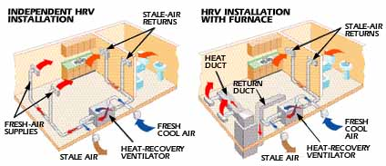
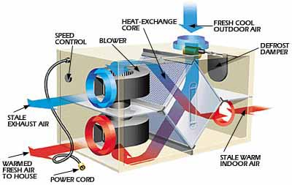
Heat Recovery Ventilator

Slide 11
A3. Community Energy Plans cut emissions by 75%
Option one
  to prepare a plan for a new neighbourhood in London Ontario where the developer has 75 acres and wants to build a Net-Zero Energy Neighbourhood for 2,000 households.
Option two
  to prepare a community energy plan to reduce emissions for an existing community (size = 10,000, 100,000, or 1 million population) by 75 percent.

Slide 12
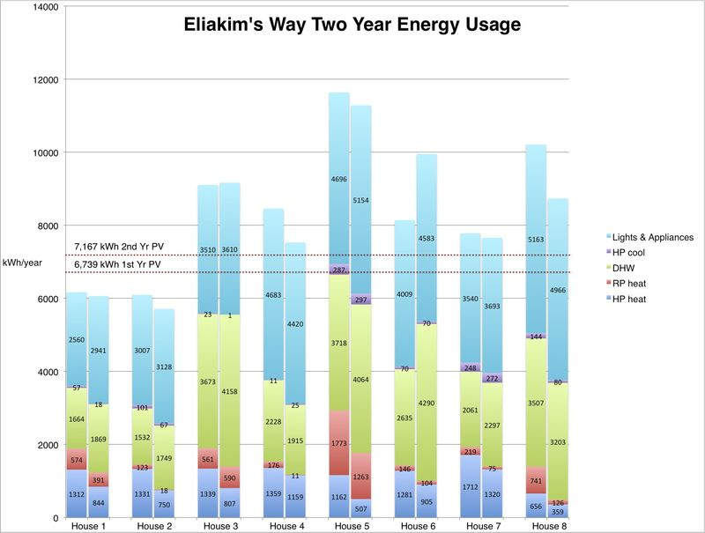
Net Zero Energy Possible Homes
http://blog.energysmiths.com/2012/06/two-years-of-energy-usage-at-eliakims-way.html

Slide 13
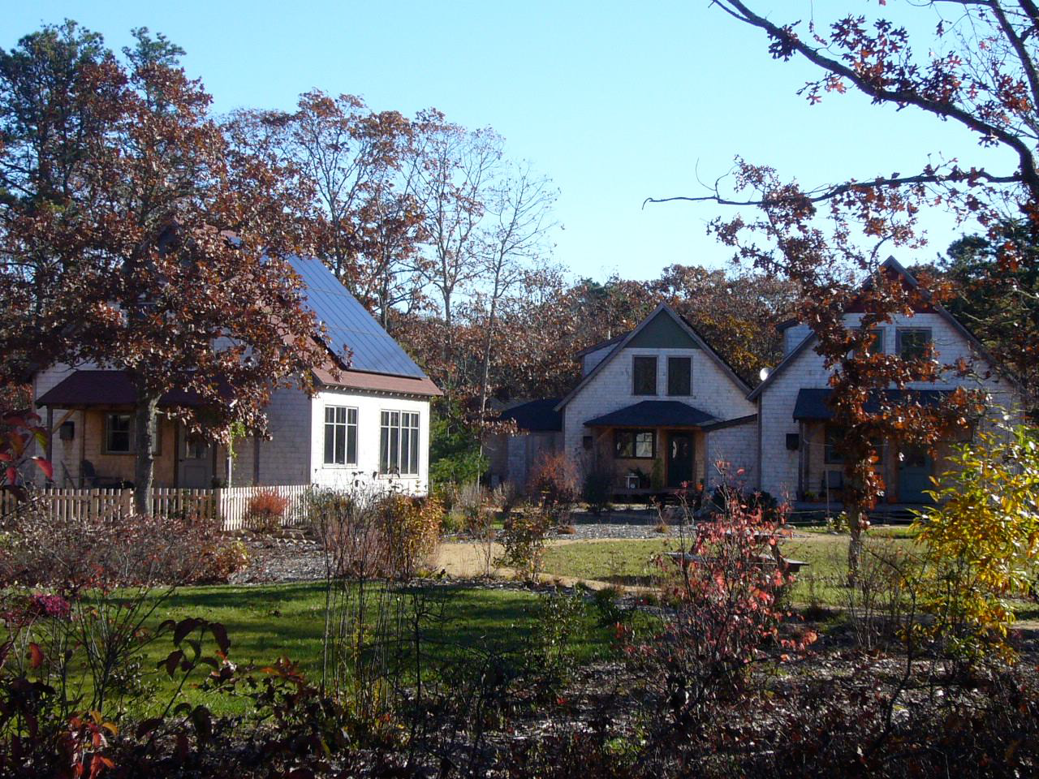
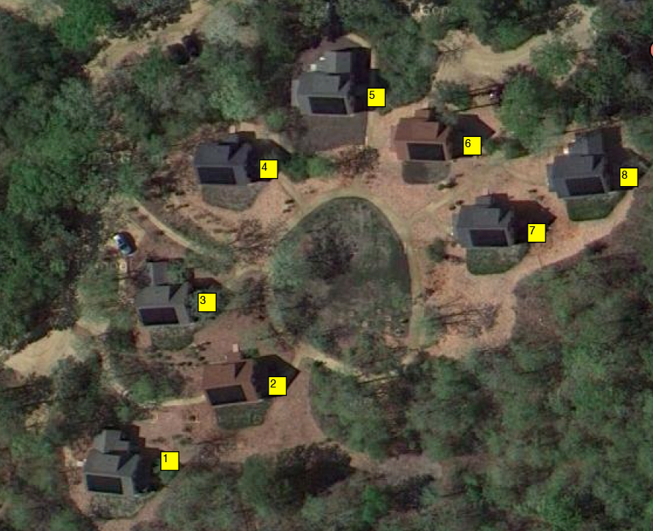
Eliakim’s Way Net Zero Homes
http://www.energysmiths.com/resources/documents/EliakimsEnergyMediaReportFullwCopyrightv2.pdf

Slide 14
Summary
Remember: ‘the house as a system’
  Efficiency measures often lowest cost
  Renewables
  Integrated smart system and flexible settings for user preferences
  System electronics to improve pv performance
    Charge controllers
    maximize output for different angles and shading

Slide 15
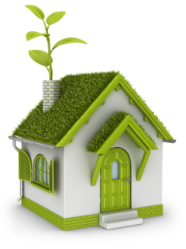
Other assessment?
Final Exam
  Textbook
  Course notes
Questions…

