Slide 1


Sustainable Energy and Building Technology
3-Year Advanced Diploma
Teaching Energy Efficiency at the Post-Secondary Level
July 16-17, York University – Executive Learning Centre
Kerry Johnston

Slide 2
  The program prepares graduates for project management roles related to:
    Energy conservation/efficiency/management – primarily existing buildings
      Auditing, modeling, building automation systems
    Green/sustainable building practices - mostly new buildings
      Toronto Green Development Standard, Ontario Building Code
    Implementation of renewable energy technologies
      Ontario’s Long Term Energy Plan –what most people don’t know about “cheap” electricity
    Sustainable community/urban development
      Ontario’s response to Urban Sprawl – grey to green infrastructure

Slide 3
Applied Research Projects
Industry Partner: RTS Controls Ltd
Faculty Lead: Dragos Paraschiv, SAT, Sustainable Energy and Building Technology (SEBT)
Project Title: “Energy Use Monitoring & Targeting Multi-Unit Residential Buildings”
Dates: February 2012 - January 2013
RTS partnered with Humber in 2012 to test a real-time energy consumption meter. Two identical high-rise buildings in the GTA acted as the pilot sites programmed with RTS technology for this project. The objectives were to integrate two existing technologies – automation systems, which control energy systems (e.g. heating/air conditioning), and smart meters, which measure energy consumption in real-time – to 1) perform an energy audit (recommended by Toronto Hydro); 2) develop two processes for efficient energy usage; and 3) measure the results and compare them via historical data. This technology will reduce energy usage and increase cost savings. Students from Humber’s SEBT gained practical, hands-on experience and the skills to integrate and evaluate existing systems with innovative new technologies
BlueGreen Consulting is a dynamic company that provides practical a wide variety of technical services for high performance new homes as well as deep energy retrofitted vintage homes. With many aging homes in Toronto experiencing massive heat loss, discomfort and condensation issues, BlueGreen provides the diagnostic and remediation services that keep Ontario homes comfortable and super efficient.
Greg Labbé, co-owner of BlueGreen, is collaborating with Humber faculty Kerry Johnston & Dragos Paraschiv, from the Sustainable Energy and Building Technology (SEBT) program, to measure air leakage of vintage brick semi-detached and town homes in the Junction and Riverdale neighborhoods of Toronto. This study aims to improve modeled energy savings projection accuracy for government energy efficiency programs including utility based conservation programs for low income Canadians. Using a blower door that mounts into the frame of an exterior door of a house, students from the SEBT program at Humber will measure the air infiltration rate of participating attached homes simultaneously. The data collected will help homeowners and contractors make informed decisions when retrofitting older homes effectively and durably, increase the energy performance of Ontario housing, and provide the industry partner with valuable information to identify areas of energy savings in aging buildings.
This project is being supported by a grant from the Natural Science and Engineering Research Council Applied Research and Development Award (NSERC-ARD) program.

Slide 4
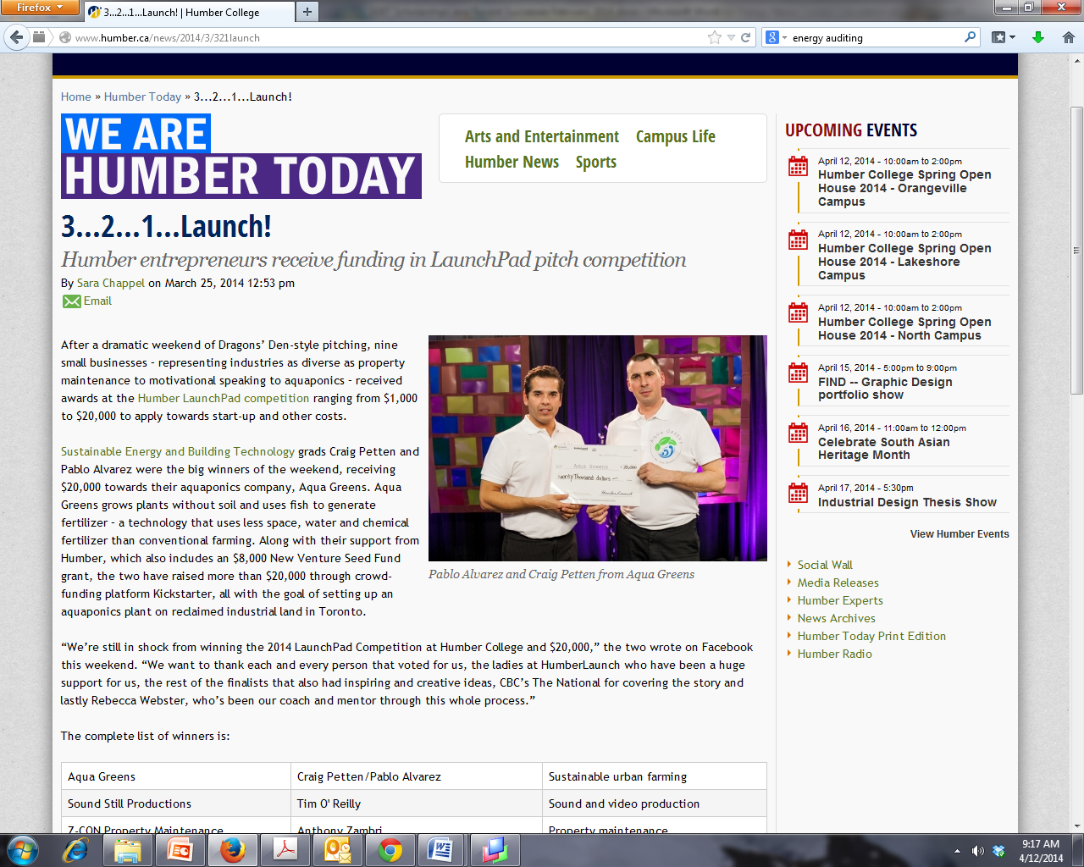

Slide 5
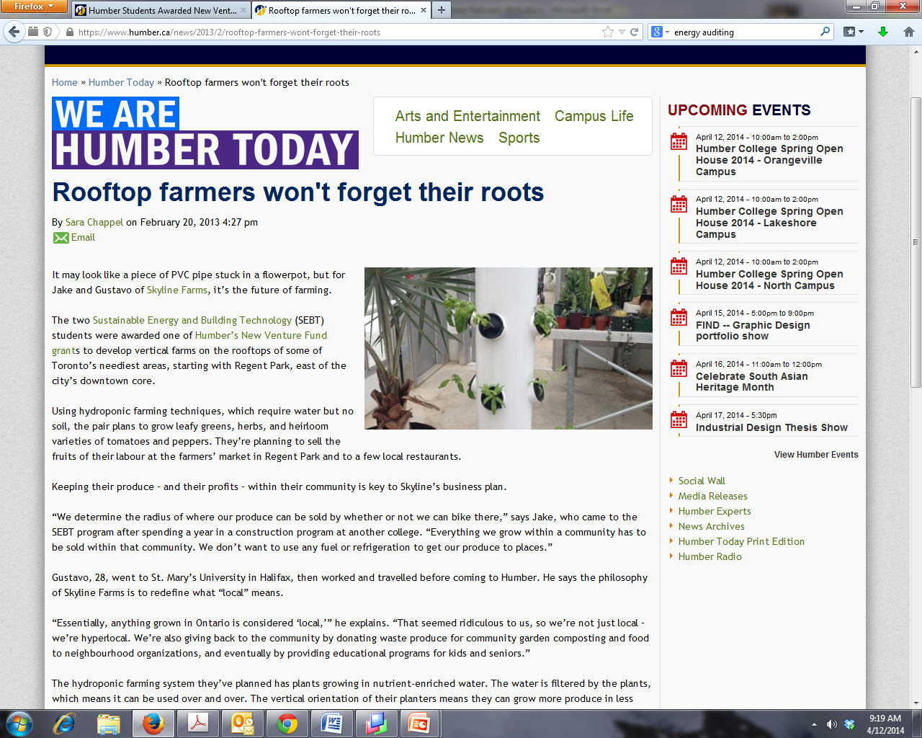

Slide 6


Slide 7
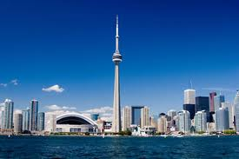
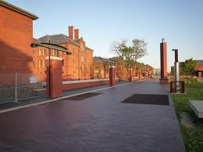
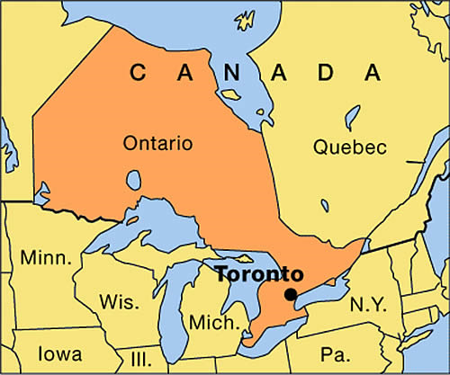
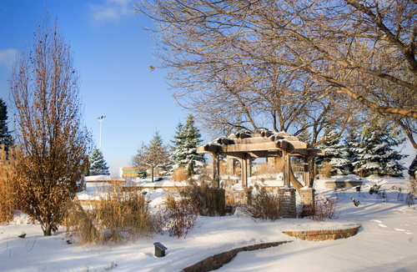
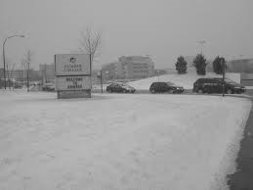
+ 35ºC = 95ºF
110ºF humidex
- 30ºC = -22ºF

Slide 8
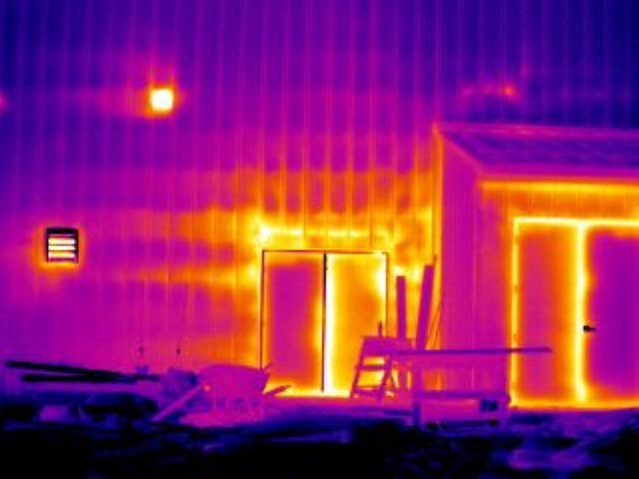
We have thousands of buildings built at a time when we didn’t care about the COST , AVAILABILITY or ENVIRONMENTAL IMPACT of the energy we use

Slide 9
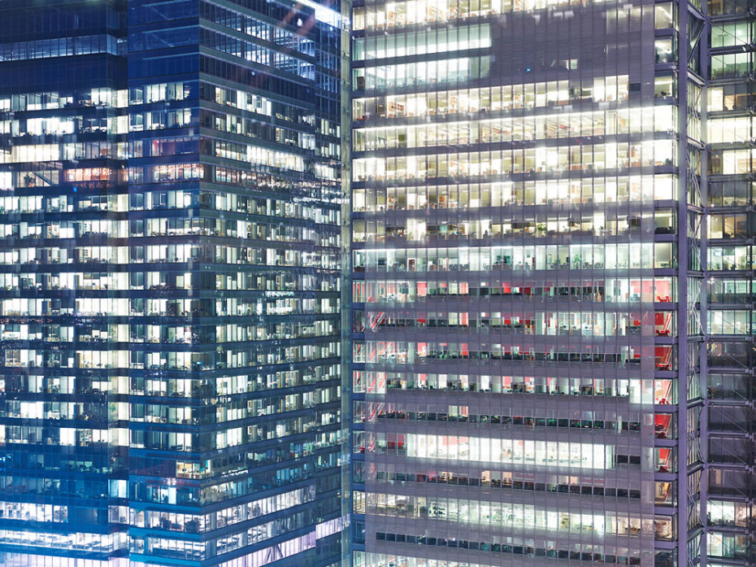
Really?

Slide 10
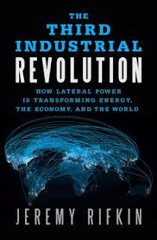
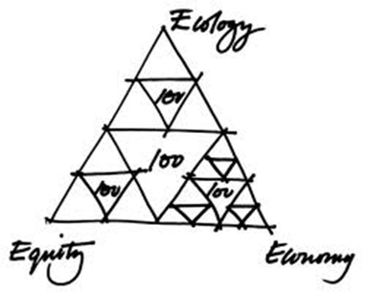

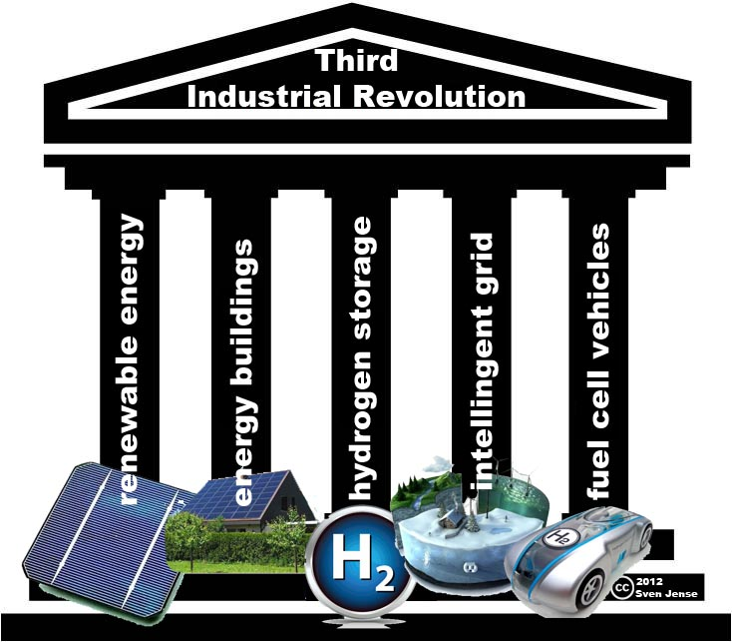
Why aren’t these big ideas easy to implement?
What’s the role of government?
Carrots and Sticks…

Slide 11
SNRG 208 Renewable Energy and Green Building Policies and Programs
3rd semester course – they’ve done basic building systems and processes, renewables, energy metrics, electric circuits, 2 x Tech Math, 2 x Communications
Lectures, case studies: in-class + assignment based; student presentations; concept maps; guest speakers – grads at Enbridge, Kitchener Wilmot Power, Newfoundland Power, consultants – auditing, modeling; BAS consultants; municipalities… O. Reg 397-11
Numbers mean something – outsider to insider

Slide 12
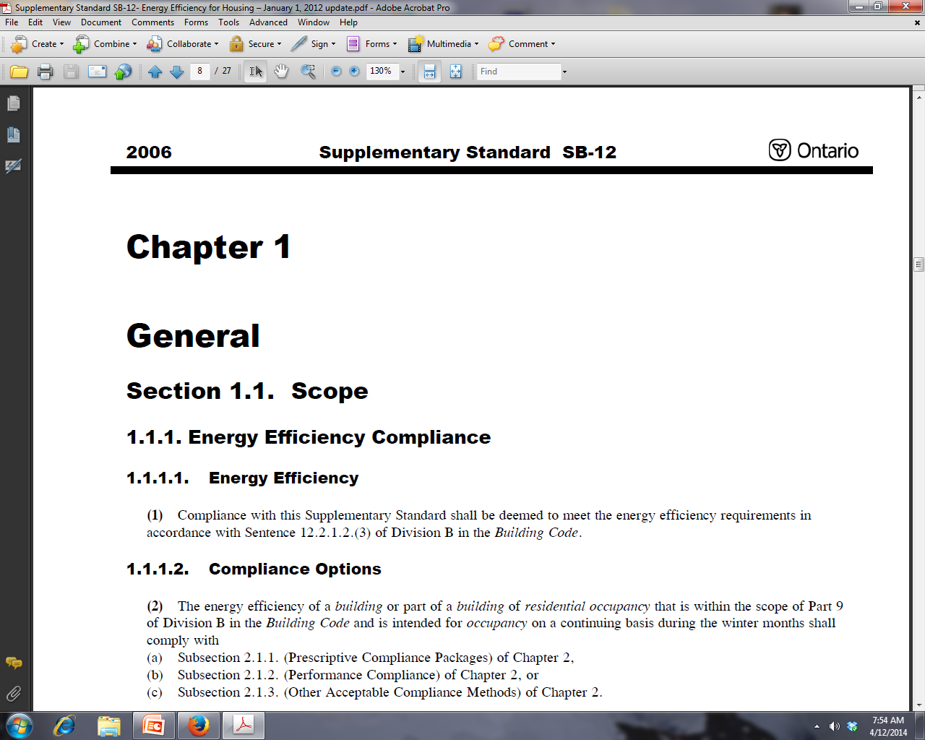

Slide 13
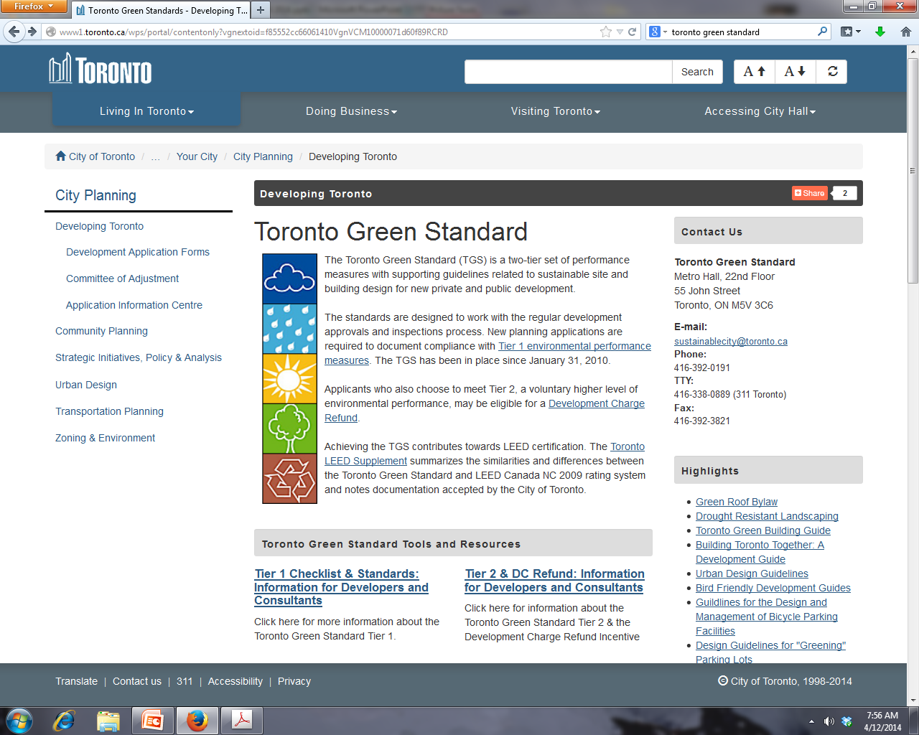

Slide 14
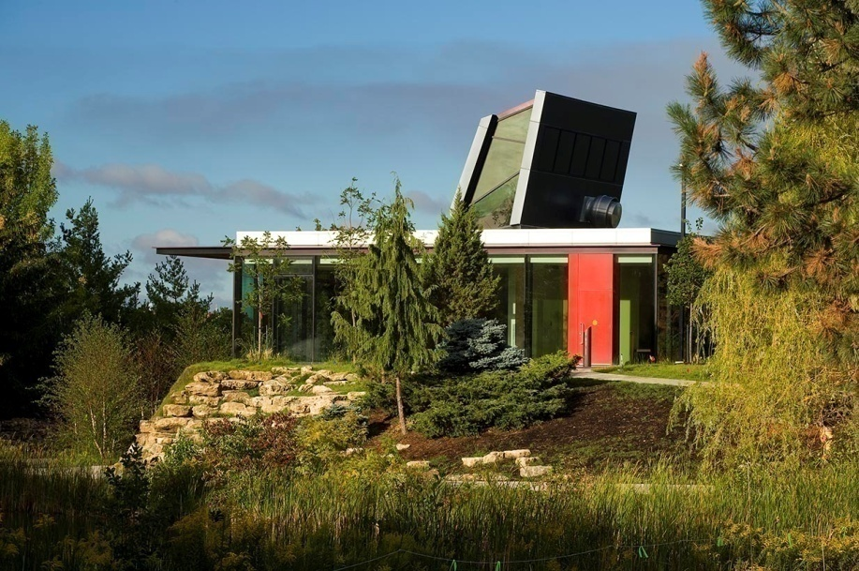
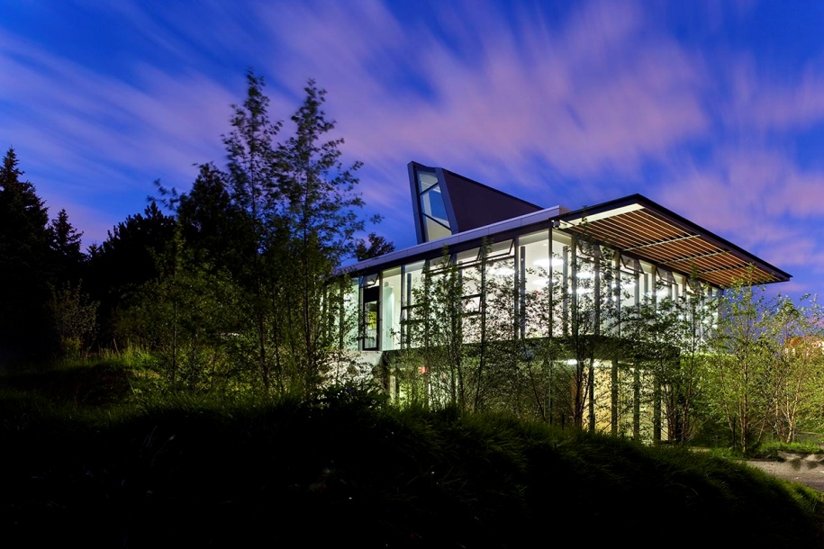
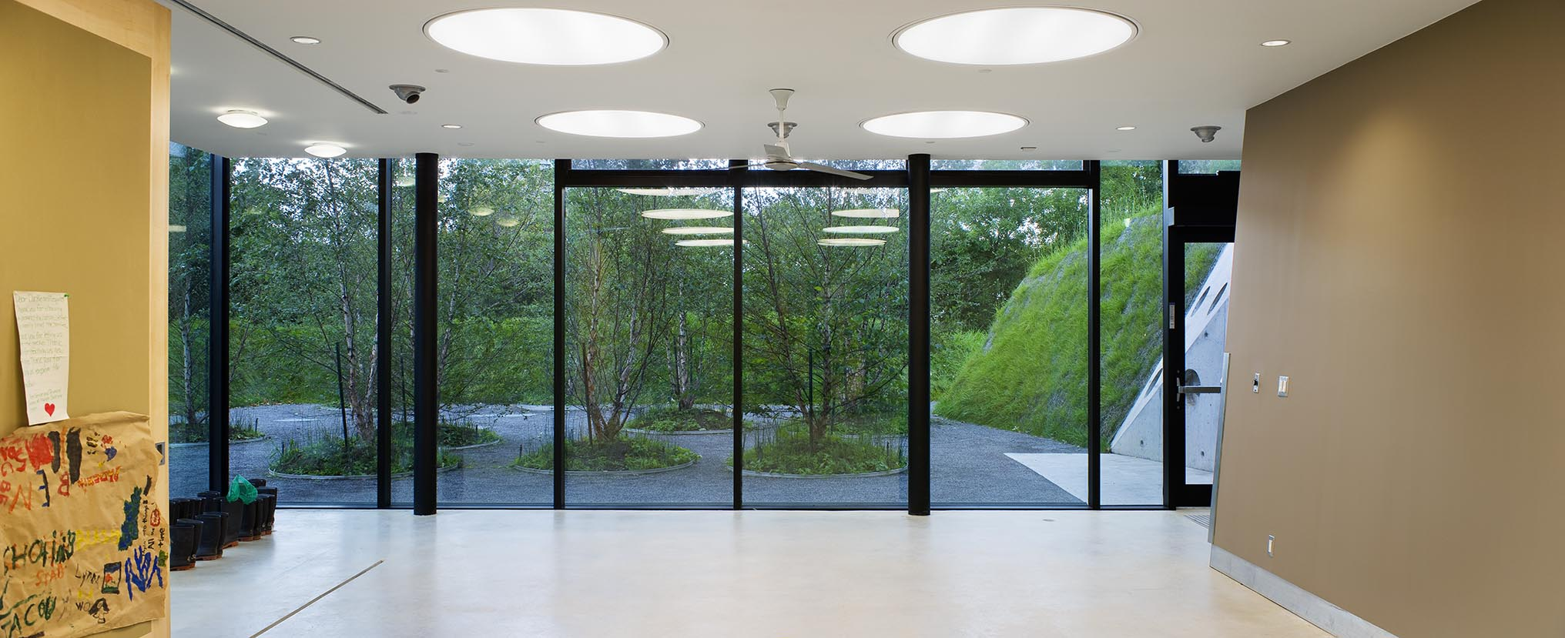
Humber’s LEED Gold Centre for Urban Ecology

Slide 15
Ontario’s Long Term Energy Plan
Installed Capacity | 2003 | 2010 | 2030 (Projected)
Nuclear | 10,061 | 11,446 | 12,000
Renewables – Hydroelectric | 7,880 | 8,127 | 9,000
Renewables – Wind, Solar, Bioenergy | 155 | 1,657 | 10,700
Gas | 4,364 | 9,424 | 9,200
Coal | 7,546 | 4,484 | 0
Conservation | 0 | 1,837 | 7,100
Total | 30,006 | 36,975 | 48,000

Slide 16
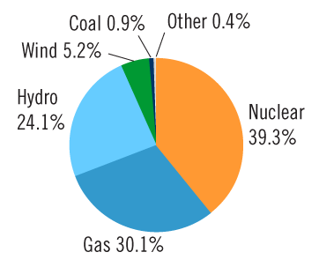
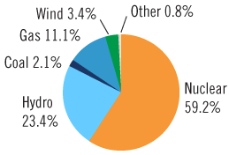
Electricity in Ontario
Energy Output By Fuel Type 2013
Current Supply Mix - Potential 32,961 MW
Season | Seasonal Normal Weather Peak (MW) | Extreme Weather Peak (MW)
Summer 2011 | 23,539 | 26,073
Winter 2011-12 | 22,495 | 23,765
Summer 2012 | 23,712 | 26,269

Slide 17
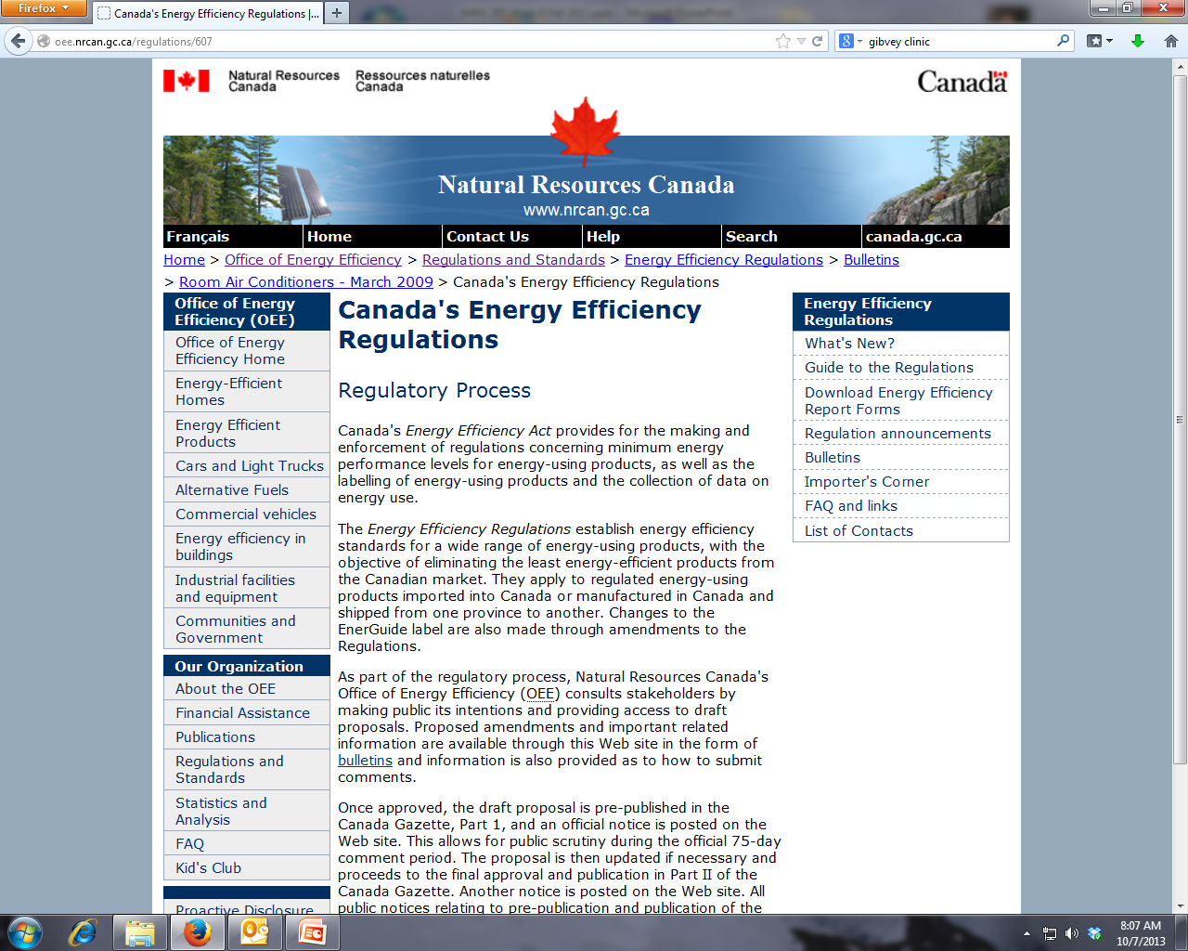

Slide 18
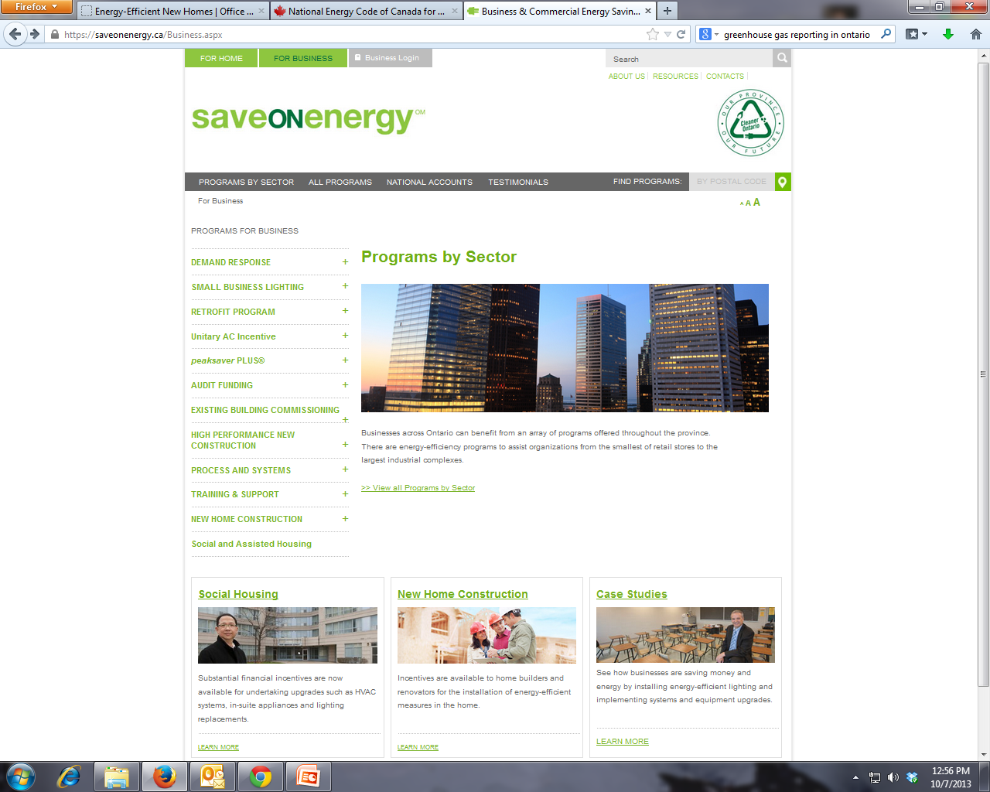

Slide 19
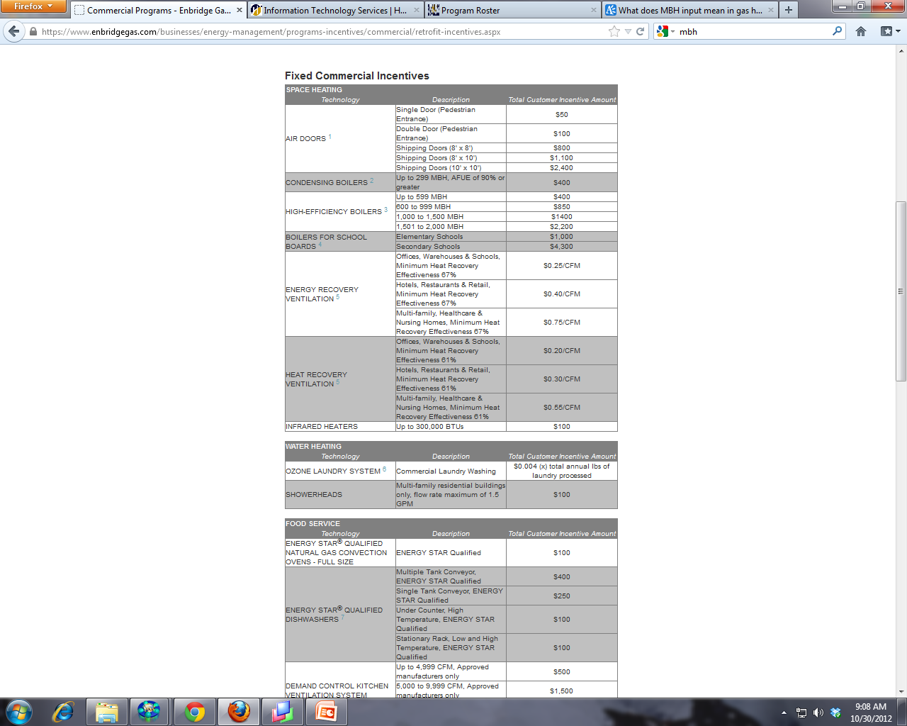
Enbridge Gas

Slide 20
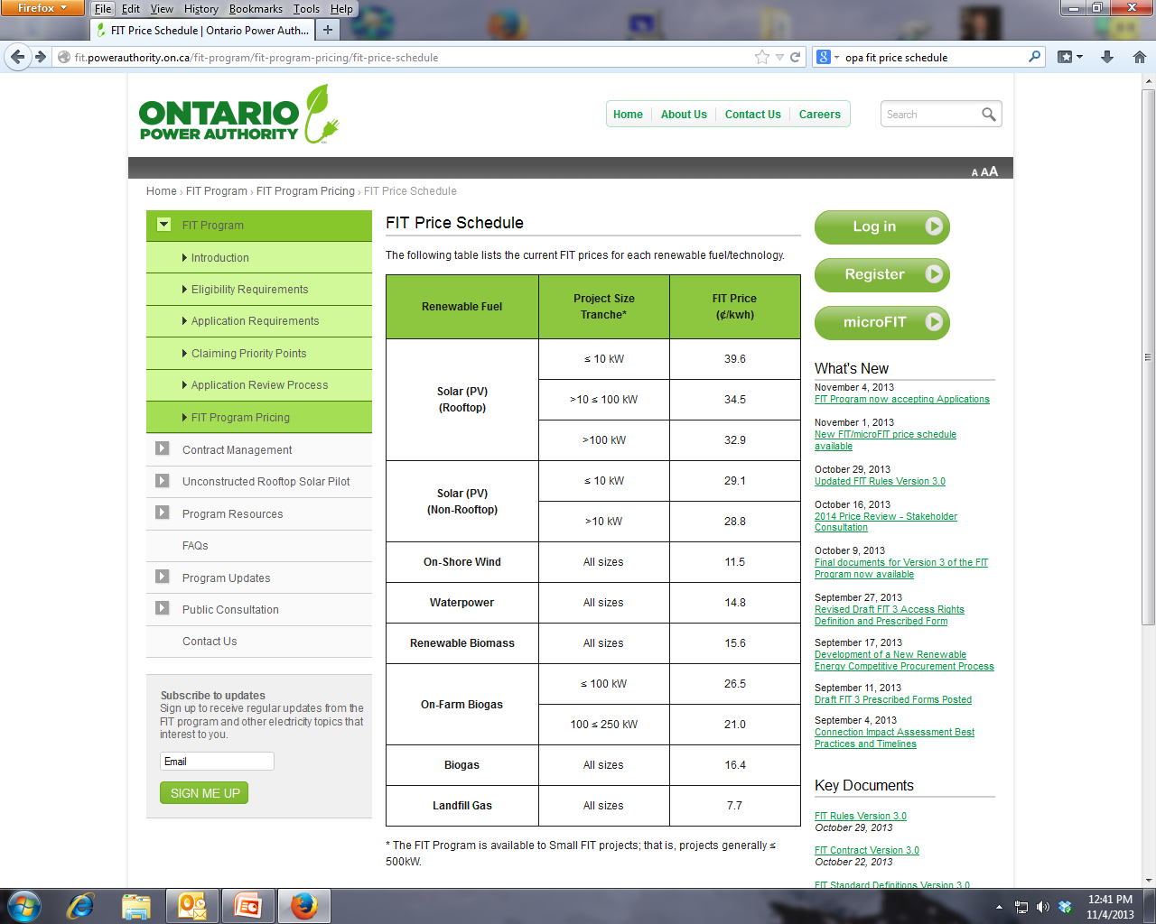

Slide 21

Water
Emissions
Energy
Emissions
Water
Energy
Transportation
Energy
Buildings
Communities
Requires a great number of people to change their mindsets and behaviour
Sustainability
Government
Carrots
Sticks
FIT
Conservation Programs
Environmental Protection
Natural
Built

Slide 22
Please feel free to contact me for more information
Kerry Johnston
416-675-6622 ext.4512
kerry.johnston@humber.ca

