Slide 1
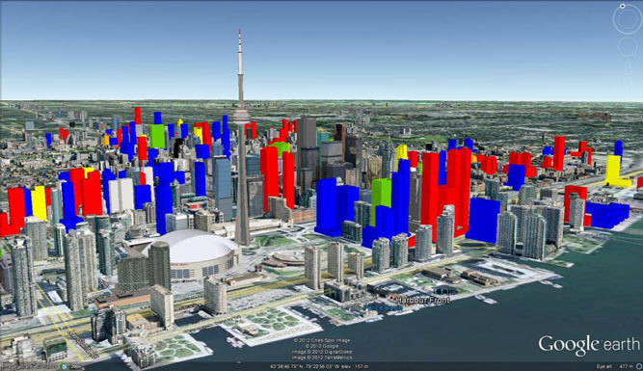
Sustainable Development and Built Environment
“If buildings work well, they enhance our lives, our communities, and our culture” (Baird, et.al. 1996: Building Evaluation Techniques)
Teaching Energy Efficiency
July 16 & 17
York University
Harsha Munasinghe
George Brown College
http://www.canadianbusiness.com/blogs-and-comment/what-torontos-skyline-will-look-like-in-2020/

Slide 2
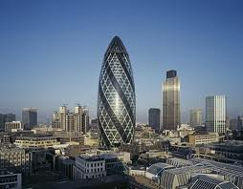
COURSE DESCRIPTION
Creates an understanding of the links between development, environment and economics
Investigates environmental problems caused by development
Explores current issues in the built environment and economics
Examines sustainable development, resource use and economic strategies
Delivered through case studies
The Gherkin, London
(Google.ca)
Bridging course from Diploma to Degree

Slide 3
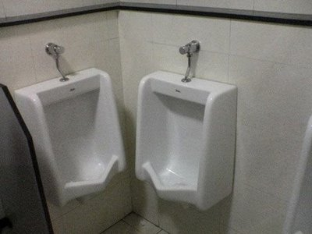
Course Outcome
Define the concepts of development and environmental sustainability;
Describe and compare the variety of environmental problems and their underlying causes and subsequent impacts;
Classify processes that generate social and environmental change;
Assess the potentials and limitations of environmental planning and management;
Develop and recommend strategies to steer sustainable urban environmental planning.
Sharing is caring!
Space Sharing is sustainable!
http://onlyfunnyjokes.com/bestoftheweb/2008/06/26/the-stupid-engineeer-awards-great-examples-of-really-bad-construction/

Slide 4
Week | Topic / Task | Outcome(s) | Content / Activities | Resources
1 | Introduction : Built Environment and Community | 1,2 | Group discussion | Course outline, GBC Policy, Handouts
2 | Built environment and Sustainable Development | 1,2 | Class activities Introduction to Assignment I | Handouts, lecture
3 | Case Study: Sustainable community planning | 2, 3,4 | Class activities Introduction to Assignment III | Handouts, lecture
4 | Current trends: Green building and Bio-mimicry | 2,3,4 | Class activities Discussion on Assignment I & III | Handouts, lecture
5 | Energy and Building Design | 4,5 | Class activities | Handouts, lecture
6 | Case study: Energy modeling | 1,2,3,4,5 | Class activities | Lectures, Presentations
7 | Case study: Renovated built environments / Midterm Exam | 1,2,3,4,5 | Submission of Assignment I Introduction to Assignment II | Lectures, Presentations
8 | INTERSESSION WEEK
9 | Field trip to Evergreen | 1,2,3 | Group Discussion
10 | Building Renovation & Ergonomics | 1,2,3,4,5 | Submission of Field Trip Report Discussion on Assignment III | Handouts and presentations
11 | Urban environments | 1,2,3 | Class activities | Handouts and presentations
12 | Indoor quality and Health | 3,4,5 | Class activities | Handouts and presentations
13 | Case study: Building in operation | 1,2,3,4,5 | Class activities Student presentations | Handouts and presentations
14 | Case study: Post occupancy survey | 1,2,3,4,5 | Student presentations | Handouts and presentations
15 | Case study: Economic impact of environment / Final Exam | 1,2,3,4,5 |  | Handouts and presentations
Please note: this schedule may change as resources and circumstances require. For information on withdrawing from this course without academic penalty, please refer to the College Academic Calendar:
CN Tower, Toronto

Slide 5
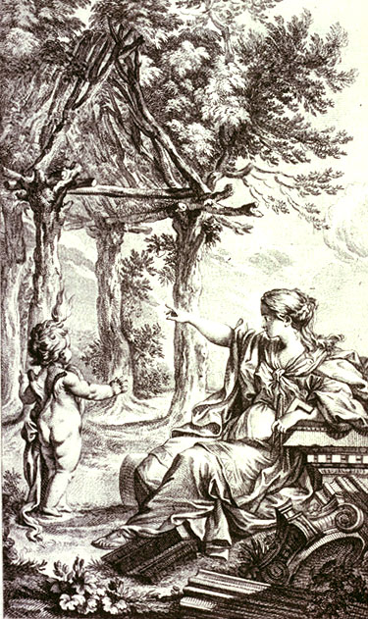
Environment and Community
Building is more than the basic Shelter:
Utilitarian art & Visual art, shaping space for human use and to express ideas
Expresses identity, culture,
Represents the location and considered as an extension to nature
Vitruvius:
Firmness, Commodity and Delight
The Primitive Hut
Abbe Marc-Antonie Laugier
(www.arch.ttu.edu/people/faculty/buelinckx_h/Spring2008/

Slide 6
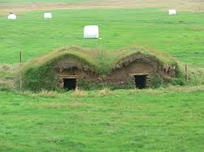
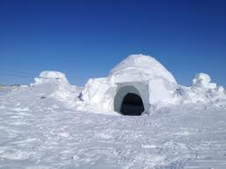
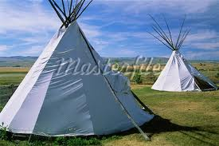
Why build?
Built environment as enforcing an order desirable to the society
Availability of resources: materials, know-how
What was available in the immediate surroundings
How to assemble the available materials together
Did we all follow the same principles?
(Google.ca)

Slide 7
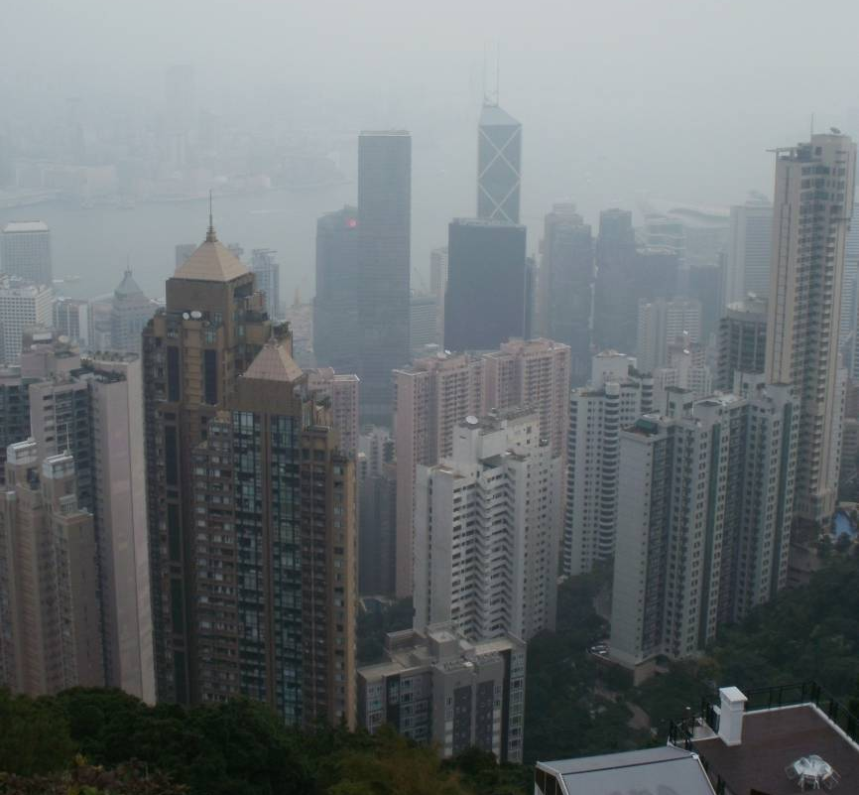
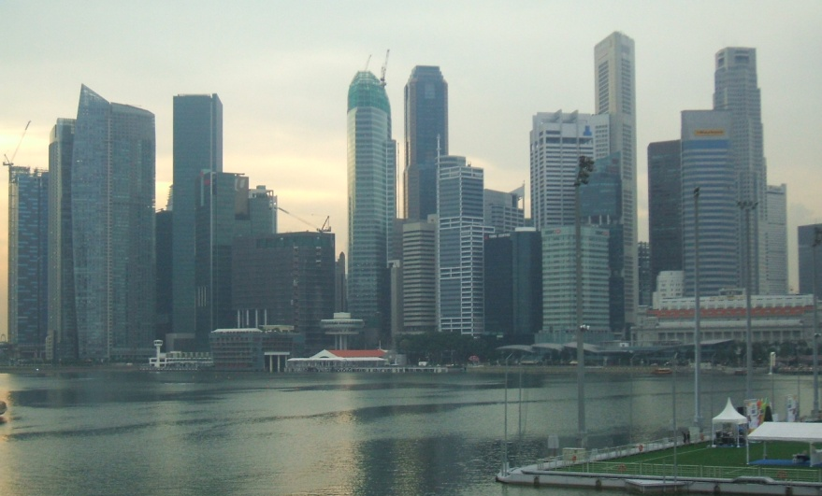
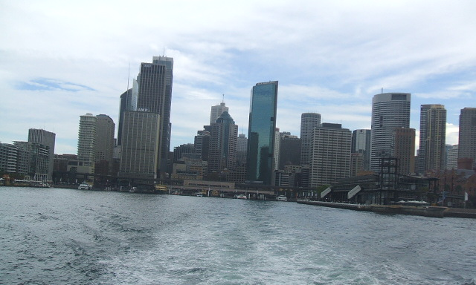
Diversity and Placelessness
Religious buildings to elevate human spirit
State buildings to show strength
Public buildings to create communal feelings
Commercial buildings to attract customers
Residential buildings to facilitate warmth and living
Society evolves and diversifies thus demanding various built forms
Buildings for wants or needs

Slide 8
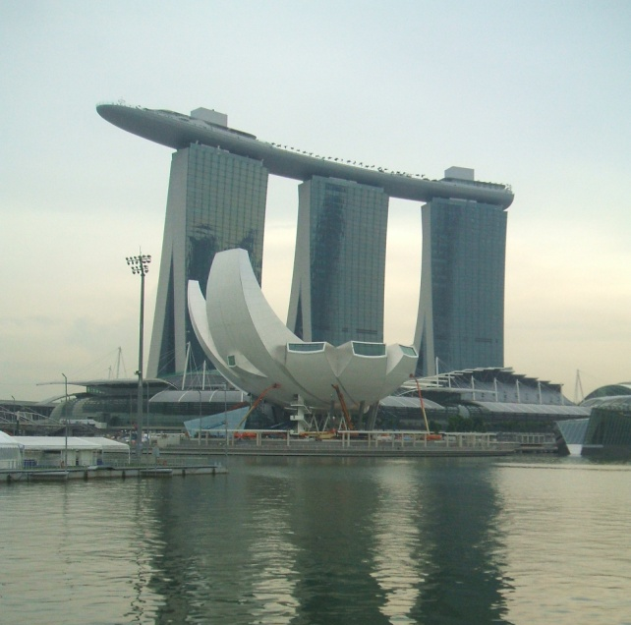
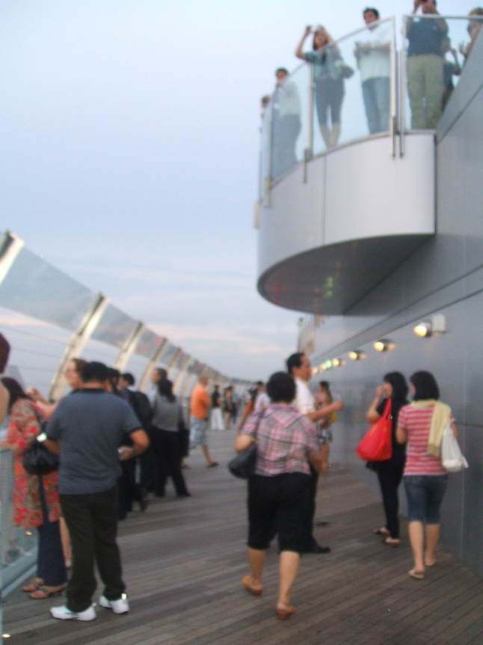
Built Environment for whom?
Need of an integrated approach
Use of multi-criteria analysis
Need of a robust product that could evolve
Use of a wholesome approach to teach the practitioners and the society
Sky Park Singapore

