Slide 1
Teaching Energy Efficiency – My Approach
Danny Harvey
Department of Geography
University of Toronto
17 July 2014

Slide 2


Slide 3
The textbook considers energy supply efficiency
-generation of electricity from fossil fuels
-and district energy systems and end use efficiency in each end use sector:
- transportation
- buildings
- industry
- agriculture
- municipal services (water supply, waste water treatment, solid waste management, recreational facilities)

Slide 4
In each supply and end use chapter, there is a common template that covers:
- the breakdown of energy use today in that sector in different world regions
- the physics of how energy is used and the physical principles underlying large improvements in energy efficiency
- a focus on the integration of options from the device to the system scale and including behavioural factors
- best-case examples from around the world
- the economics/cost of achieving high efficiency
- obstacles and barriers to achieving high efficiency
The book (and my course) conclude with some illustrative integrative scenarios and a broad overview of policy options

Slide 5
In my course,
I focus on just two sectors (transportation and buildings) in considerable detail, with a rather extensive Excel-based problem set for each that covers physical principles and economics
I cover two other sectors (industry and agriculture) more qualitatively, focusing on general principles of efficient use of energy, especially at the system scale

Slide 6
Course goals:
To convey an understanding of the techno-economic basis for supporting policies (such as standards and codes) that require stringent (factors of 2-4) reductions in energy use per unit of energy service
To develop an ability to carry out rough calculations on the magnitude and CCE of various measures
To gain an appreciation of the combinations of tangibles efficiency and supply-side measures that, in combination with driving forces such as population and per capita income growth, would be required in order to have a good change of achieving the stated goal of limiting global mean warming to no more than 2 C.

Slide 7
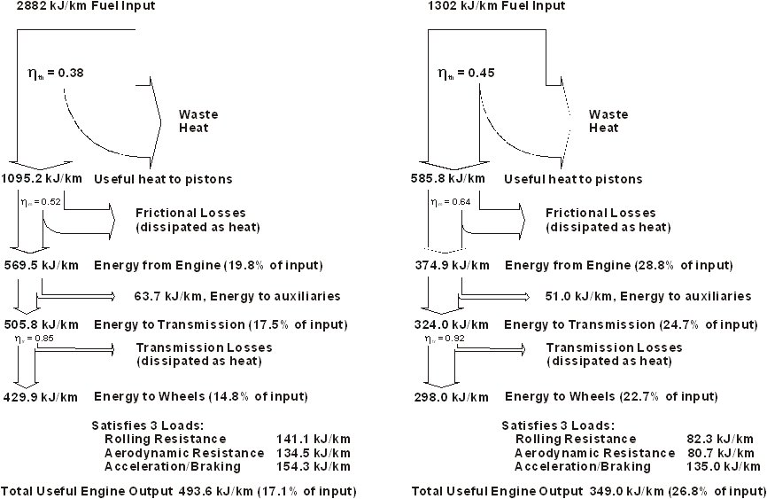
Figs 5.15-5.16 Energy flow in a typical present day car (8.9 litres/100 km, 26.4 mpg) (left) and advanced vehicle (4.0 litres/100 km, 58.4 mpg) (right)
Fuel Input
x Engine
Thermal
Efficiency
x Engine
Mechanical
Efficiency
- Auxiliaries
xTransmission
Efficiency
= 3 loads

Slide 8
System-level energy savings opportunities are abundant in the building sector.
One prominent example is fan energy required to move air:
P_{elec} α Q³/(η_{m}η_{f}) where Q is the air flow rate, η_{m} is the fan motor efficiency, and η_{f} is the fan aerodynamic efficiency.
One could either reduce energy use by a few percent by increasing one of the efficiencies by a few percent, or reduce energy use by a factor of eight (assuming fixed efficiencies, which is not quite correct) by cutting the require airflow in half (which in turn can be done by replacing conventional ventilation – which depends on turbulent mixing and dilution to deal with indoor air pollutants – with displacement ventilation)

Slide 9
Estimated fuel energy use (largely for heating) in
Canadian multi-unit residential buildings
Source: Danny Harvey

Slide 10
Explosive growth in the number of buildings meeting the Passive House standard in Austria

Slide 11
Biotop Office Building, Austria

Slide 12







Copper mass flow
Primary
Materials
$$η_{smelt}$$
Cathode
Melting
$$η_{fabr}$$
$${1−η}_{recycle}$$
Smelting and
Refining
Fabrication
Discarded
Scrap
Stock
Scrap
Melting
$${1−η}_{smelt}$$
$$l_{fabr}$$
${1−η}_{fabr}$-$l_{fabr}$
Grade 2 Scrap
Grade 1 Scrap
Fabrication Scrap
EOL Scrap
$$η_{recycle}$$
Waste
Waste
Waste

Slide 13
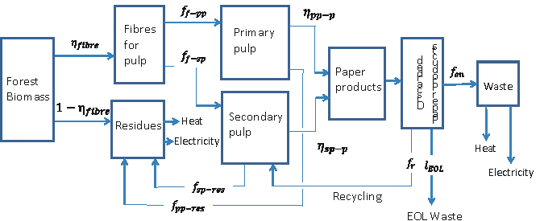
Mass flow for paper products

Slide 14
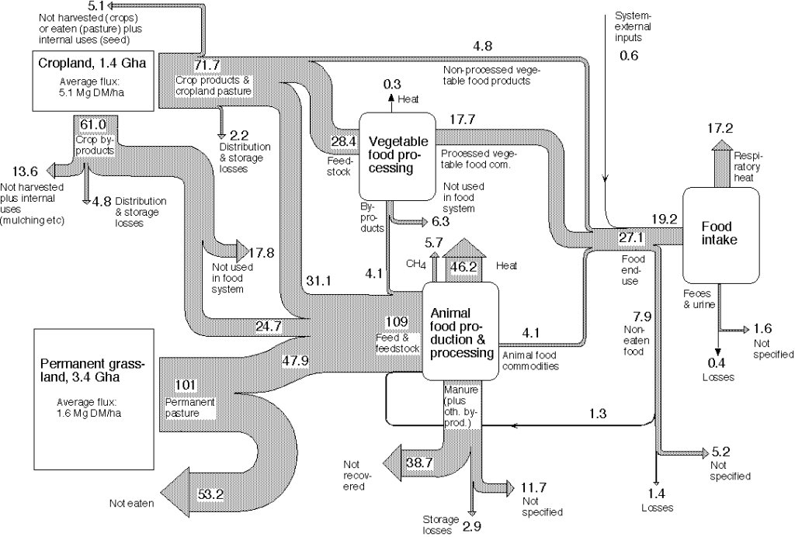
Figure 7.12 Phytomass energy flows in the world food system.
Source: Wirsenius (2003, Journal of Industrial Ecology 7, 47–80)

Slide 15
Problem Sets

