Slide 1
Local Distribution Companies (LDCs) and Conservation
York University Workshop on Teaching Energy Efficiency at the Post Secondary Level
July 16, 2014

Slide 2
Outline
About PowerStream
LDCs and Conservation
Why?
How?
Who?
Recommendations for teaching energy efficiency at post-secondary level

Slide 3
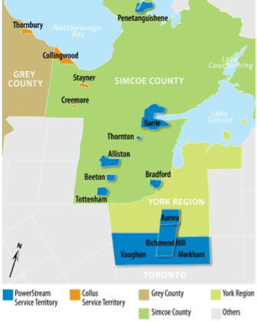
About PowerStream
More than 340,000 customers
Owned by Cities of Barrie, Markham and Vaughan
10 years old
~ 2,000 MW system peak
2012 electricity billed ~8.5 TWh
9,000 kWh per year, per residential customer
150,000 kWh per year, per general service customer
Actively involved in conservation (CDM) since 2005

Slide 5
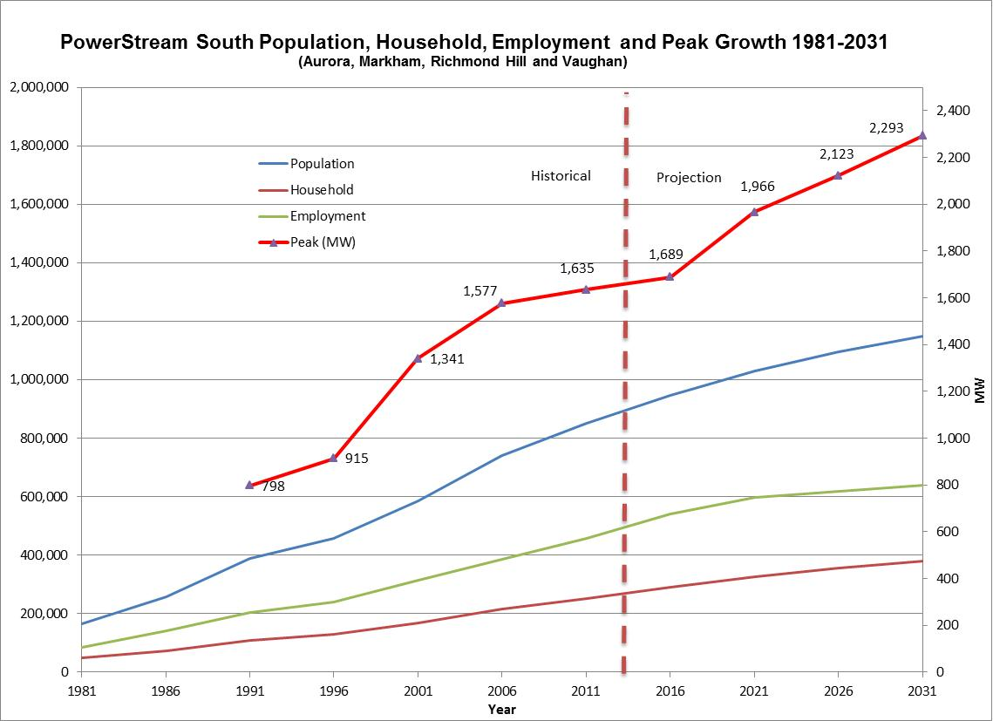
~600 MW

Slide 6
CDM at PowerStream: 2005 - present
Activities & results
Saved more than 125 MW and 1,100 GWh (cumulative) since 2005
More than 20% of residential and 40% of business customers have participated in at least one CDM program
CDM department has grown from 3 to nearly 30 individuals
Accomplishments
2013 AESP award for Outstanding Achievement in Residential Marketing & Communications
Only LDC to receive approval from regulator and deliver an LDC-designed conservation program

Slide 7
Why do LDCs do conservation?
Regulatory requirement
Customer service (help manage bills)
Business opportunity ($)
Increase brand awareness/ equity
Increase customer trust
Corporate social
responsibility/ environmental goas
Increase customer
insights
Decrease cost of arrears/ cutoffs

Slide 8
[Powerstream 2020 strategy statement]

Slide 10
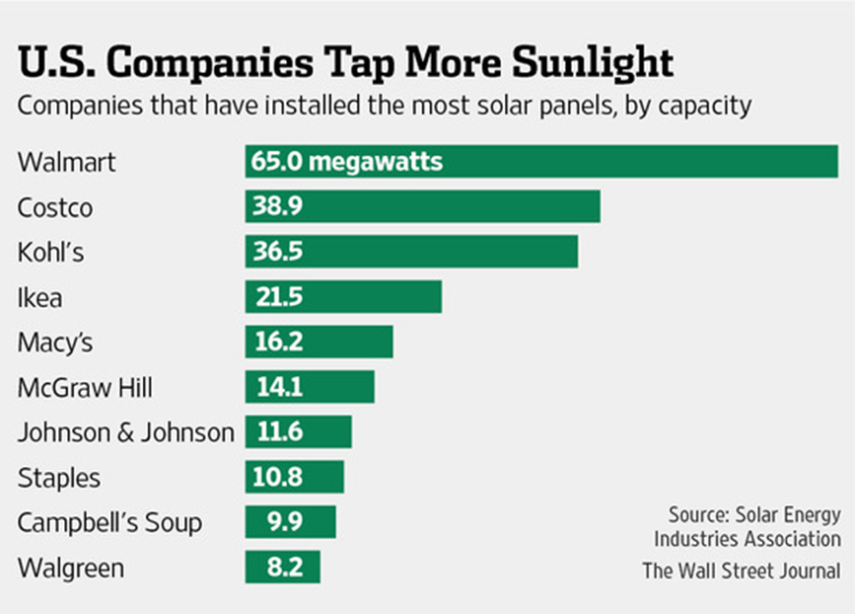
Companies Unplug From the Electric Grid, Delivering a Jolt to Utilities
“The threat to the centralized utility service model is likely to come from new technologies or customer behavioural changes that reduce load”

Slide 13
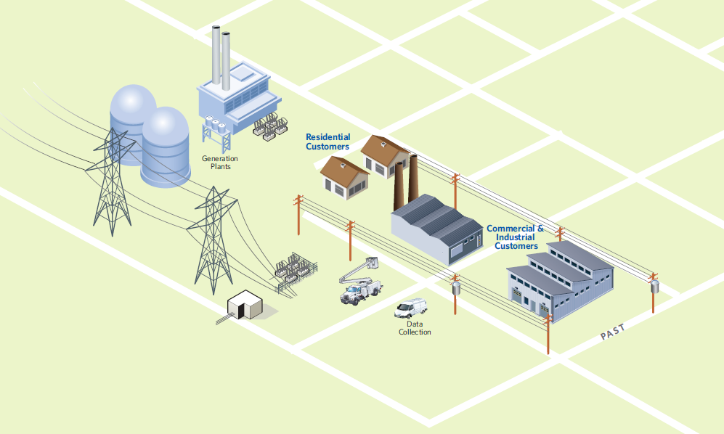
The Past - (Where We Came From)

Slide 14
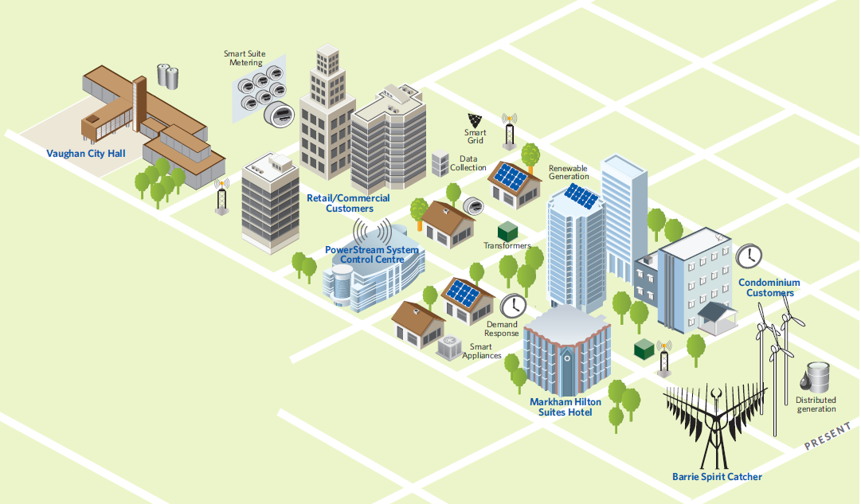
The Present - (Where We Are Today)

Slide 15
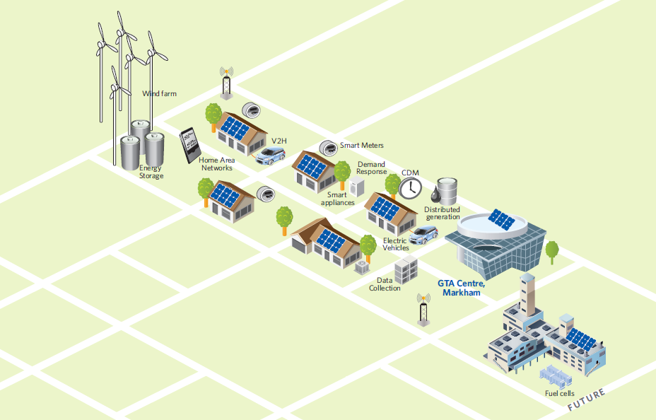
The Future - (Where We’re Going)

Slide 16
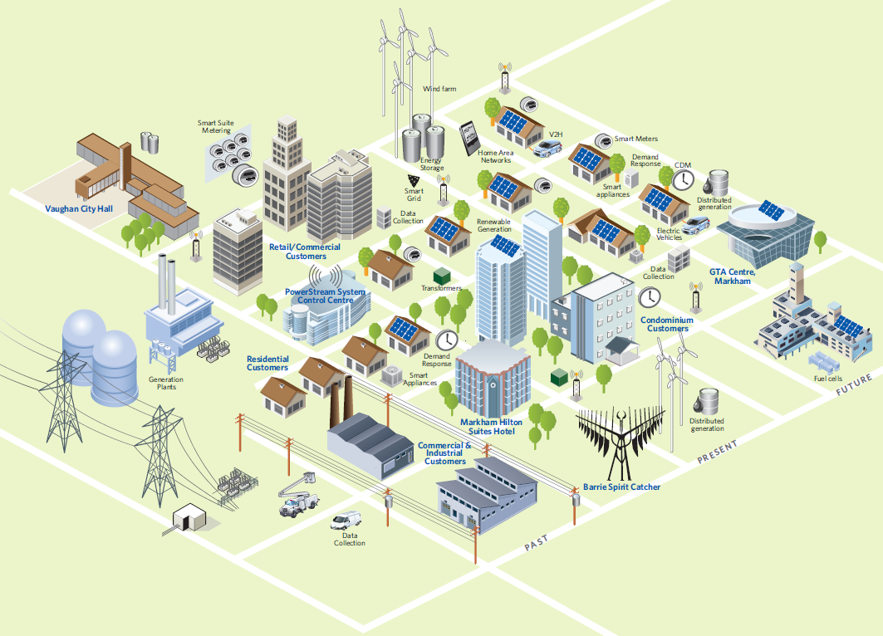
PowerStream - (Past, Present and Future)

Slide 17
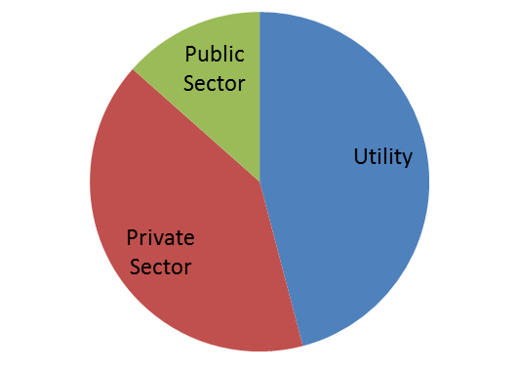
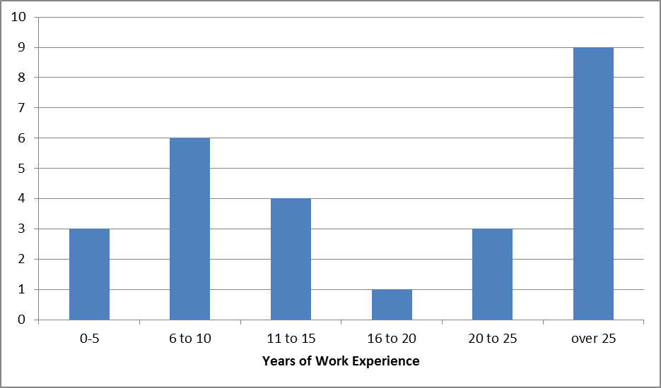
The CDM team:
What We Do
Our Experience
Leadership team | People management Strategic planning Employee engagement Policy work/gov’t relations
Program operations | Process applications Customer care Vendor management Program design
Marketing & sales | Market research Account management Sales Advertising Events
Business planning & analysis | Forecasting Reporting Data analysis
Total (average) = 20 yrs
Energy Industry = 11 yrs
CDM = 5.4 yrs

Slide 18
Teaching Energy Efficiency
Recommendations:
Take broad perspective – across jurisdictions and time
Cover the electricity fundamentals
Think outside the EE Box – convergence of conservation, smart grid and electricity sector transformation
Remember no one ‘does’ energy efficiency

Slide 19
Thank you! Raegan Bond VP, Conservation & Demand Management raegan.bond@powerstream.ca

