Slide 1
Pedagogy of Energy Efficiency and Energy Policy, UofT
Andrew Knox
July 7, 2014

Slide 2
Reverse Lectures in Energy
“Reverse Lectures”
Watch lectures at home
Do homework in class

Slide 3
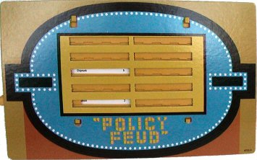

Slide 4
Policy Feud
They’ve seen the lecture on Energy Conservation Technologies
They have to create/advocate for the policies
“Name policies that will promote the use of…”
“Survey says…”
Far from paradigm
Not coercive
Highly coercive
Within paradigm

Slide 5
Open Space
Again, students have watched lectures
OPEC lecture
Historic origins of a new era in efficiency
Policy as a driver of energy systems
Peak Oil Lecture
Strong motivator for energy efficiency

Slide 6
Open Space
Framing question: “What will the future of petroleum use be?”
Other questions arise
Each question forms a breakout session
Students engage in breakout sessions
Students free to go from session to session
Teacher circulates, stimulates, advises

Slide 7
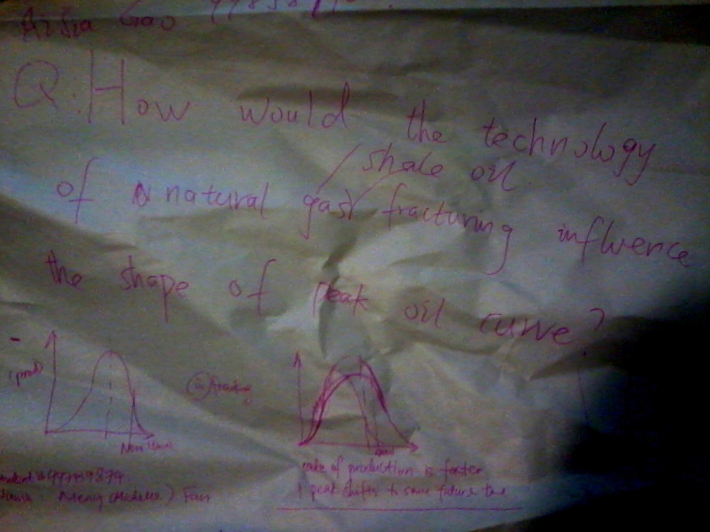
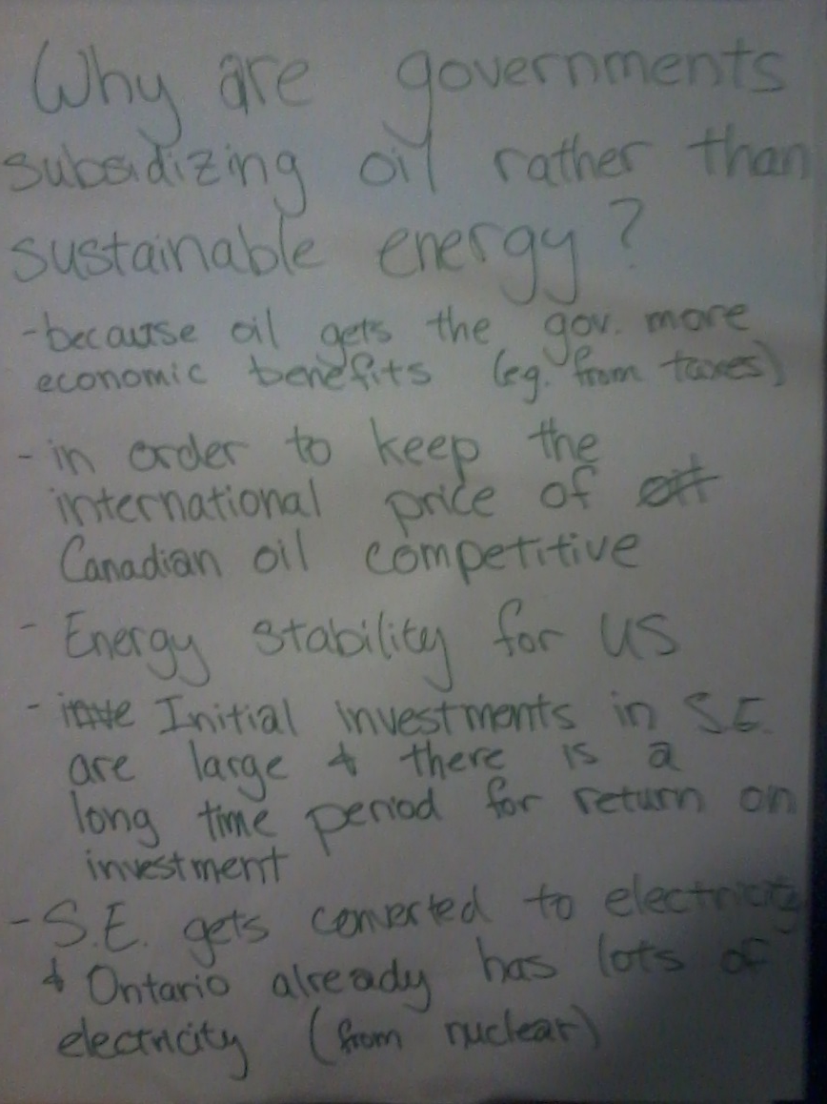
Open Space Questions

Slide 8
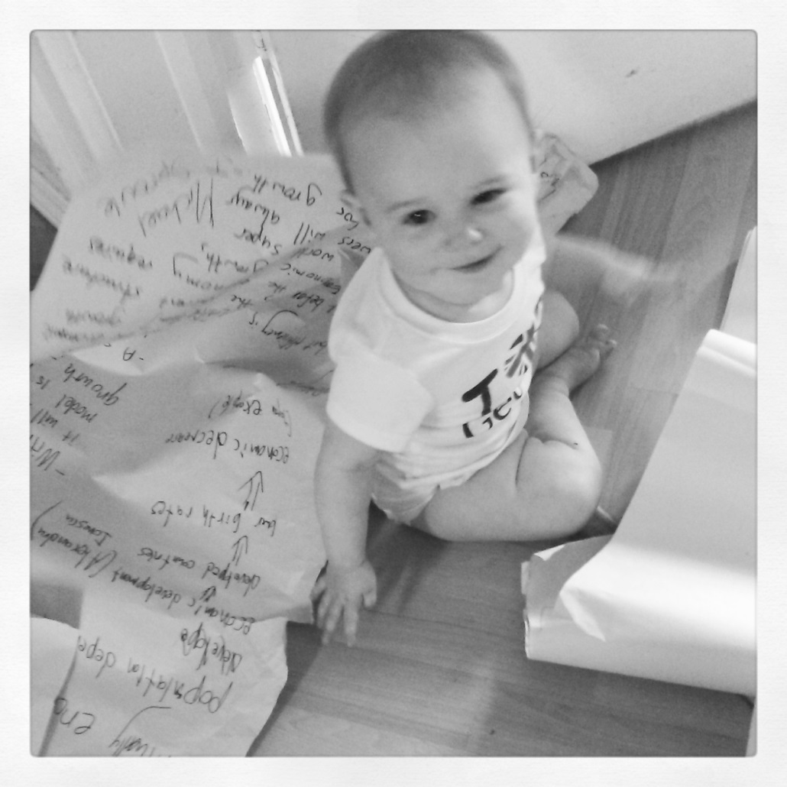
Open Space Questions

Slide 9
Open Space Questions

Slide 10
What we learned about student learning
Reverse Lectures
Students can study the videos
Open up several kinds of activities
Cover more learning styles
Building the Culture of Conservation
Get students involved
Students can exercise imagination

Slide 11
Thank you

